Slide 1
INFS 740-001 Final Project on Responsive website(static) hosting on AWS & Three-tier application architecture
Arsadur Rahman
12/12/2019

Slide 2
Project Motivation
Start A Business Responsive Website from Scratch
Learn how to utilize Amazon Web Service(AWS) Three-Tier Application Architecture
Automate some process through CLI

Slide 3
Project Goal - 01
Building a Responsive Website for a Business (Bengal Sweets)
Programing Language/Tools Used
HTML 5 – “Hypertext Markup Language is the standard markup language for documents designed to be displayed in a web browser.”
Bootstrap – “Bootstrap is a free and open-source CSS framework directed at responsive, mobile-first front-end web development”
CSS 5 – “CSS is a language of the web which when used along with HTML and JavaScript can create amazing and beautiful websites' front-end. CSS means Cascading Style Sheets” (Quora)
Java Script – “JavaScript (JS) is a lightweight, interpreted, or just-in-time compiled programming language with first-class functions”(MDN)

Slide 4
Project Goal - 02
Host the Website on AWS and Explore it’s services
Tools/services used
S3 – Object Storage
Route 53 – DNS service
CloudFront –content distribution
EC2
Certificate Manager

Slide 5
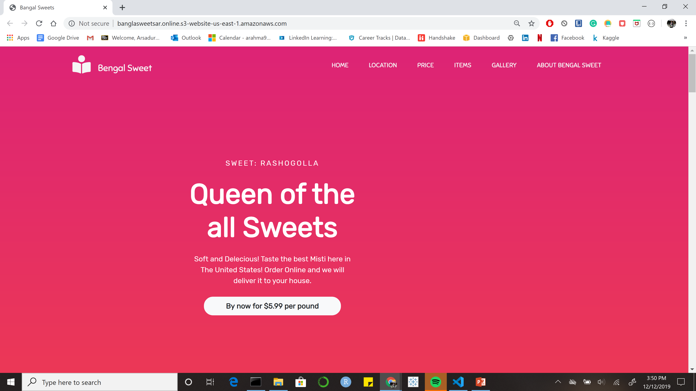
Website Demo… & Code

Slide 6
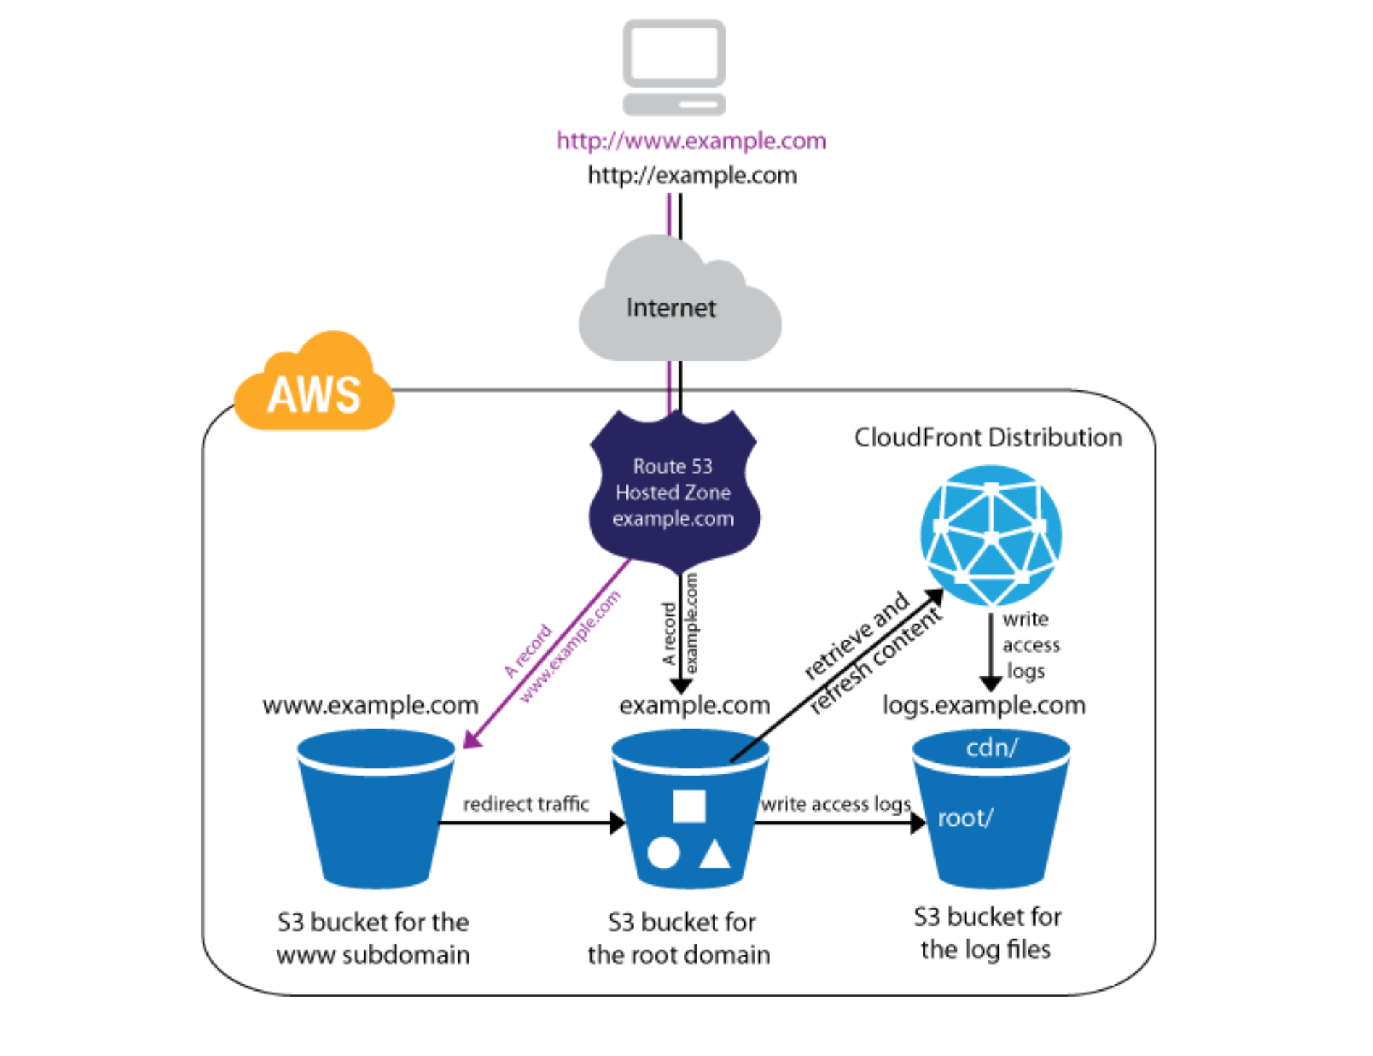
AWS Hosting Mechanism

Slide 7
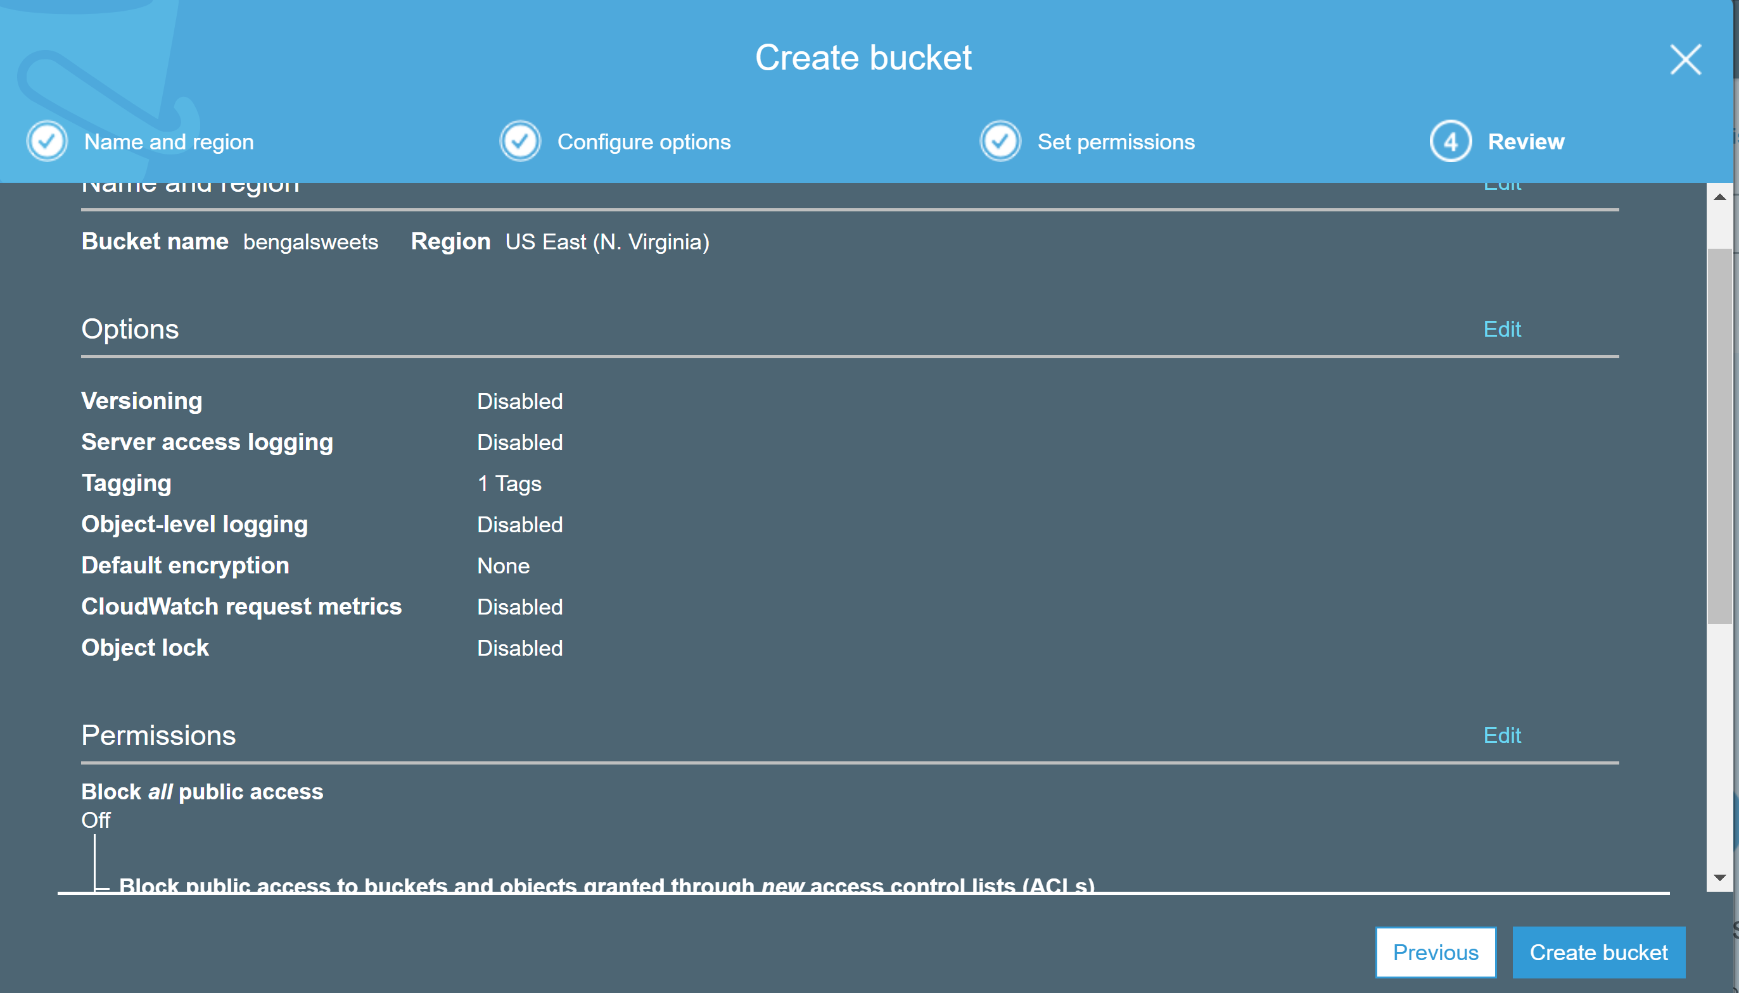

Slide 8
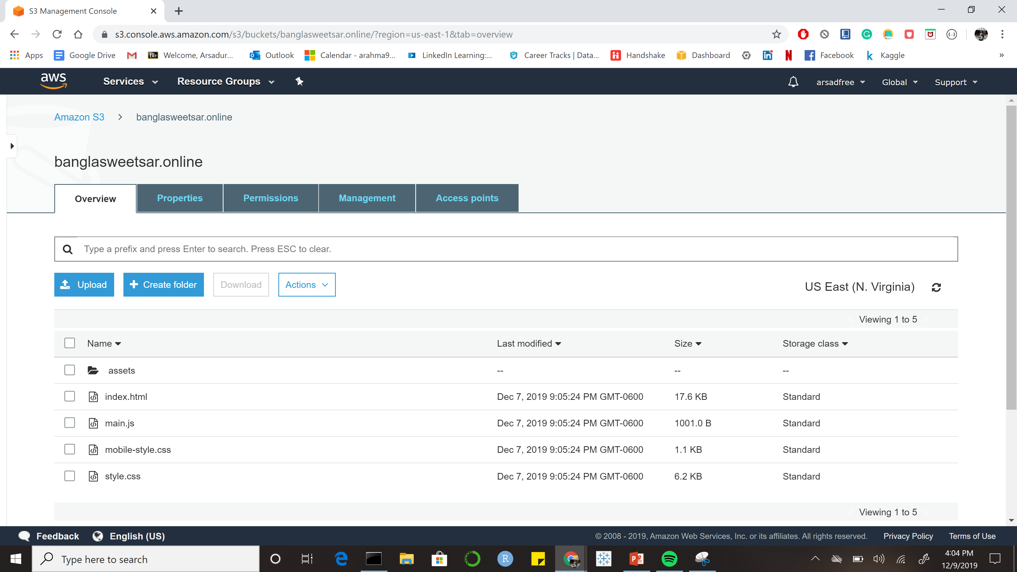

Slide 9
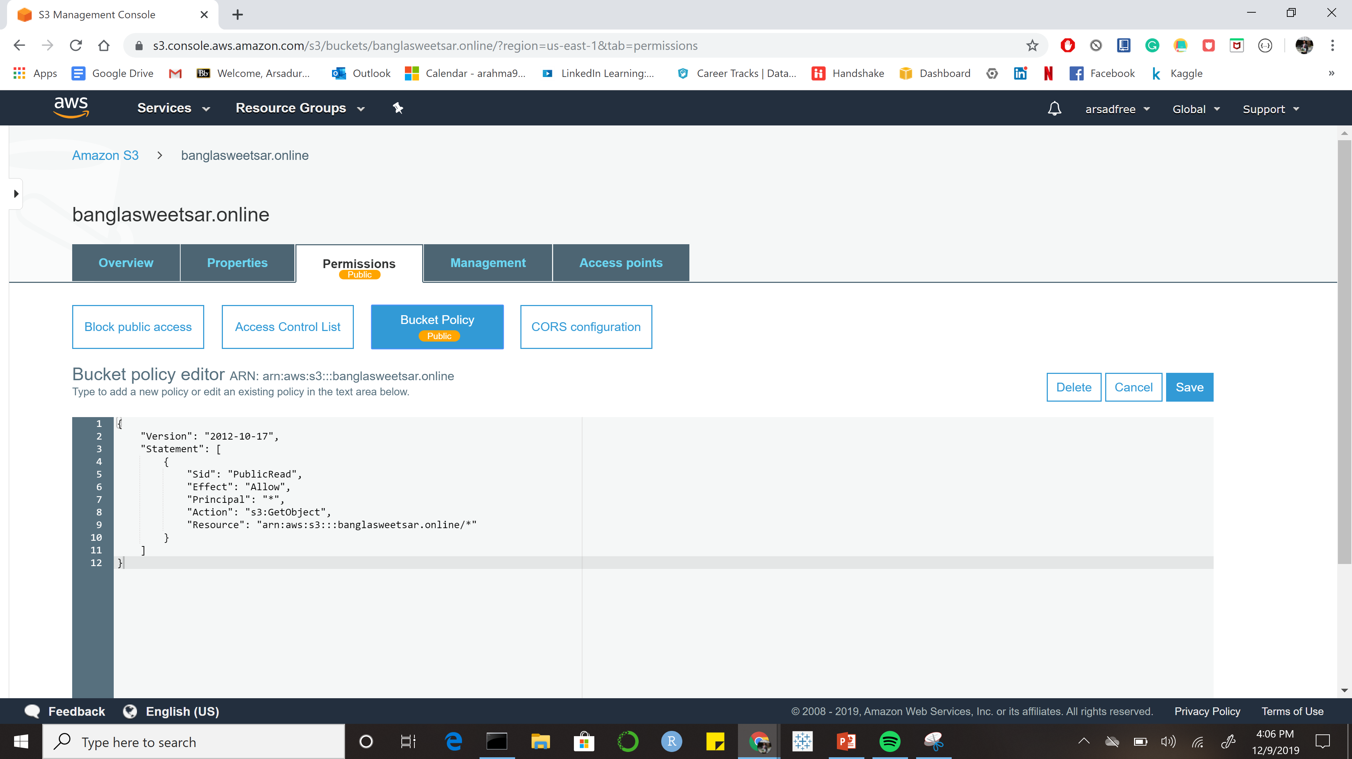

Slide 10
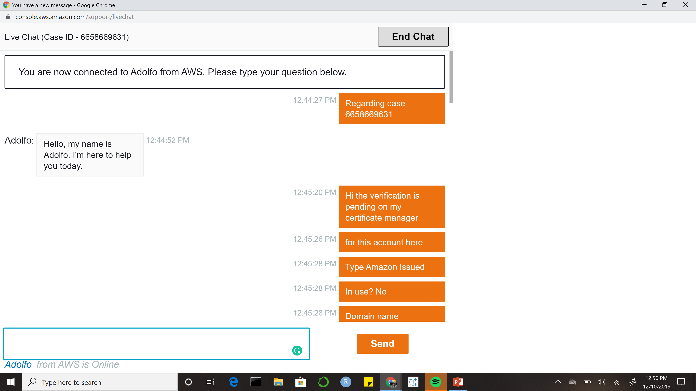

Slide 11
Why Three Tier?
Manage Each Part in an Independent way - Frontend, Backend & Database
High Availability – Distribute in different zones
Scalability – Support Traffic Demand using Load Balance
Fault Tolerant – Auto Scaling helps
Security

Slide 12
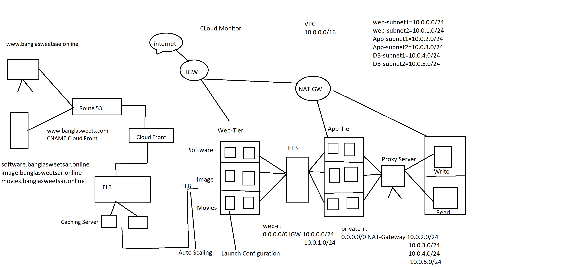
AWS three-tier Application Architecture

Slide 13
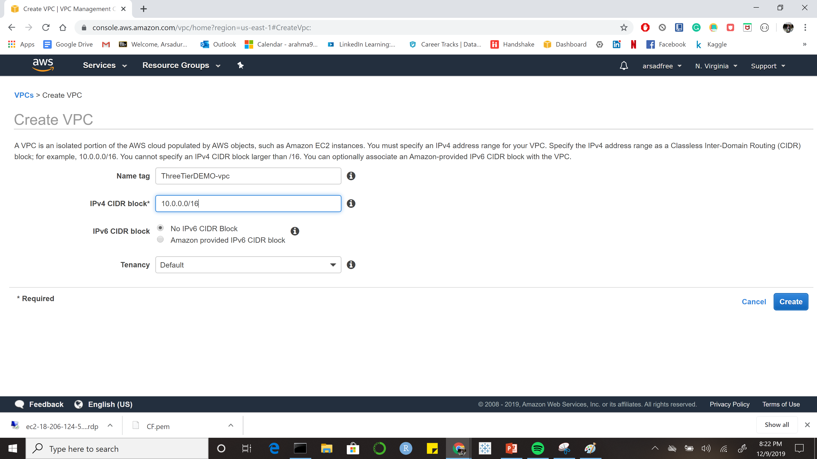

Slide 14
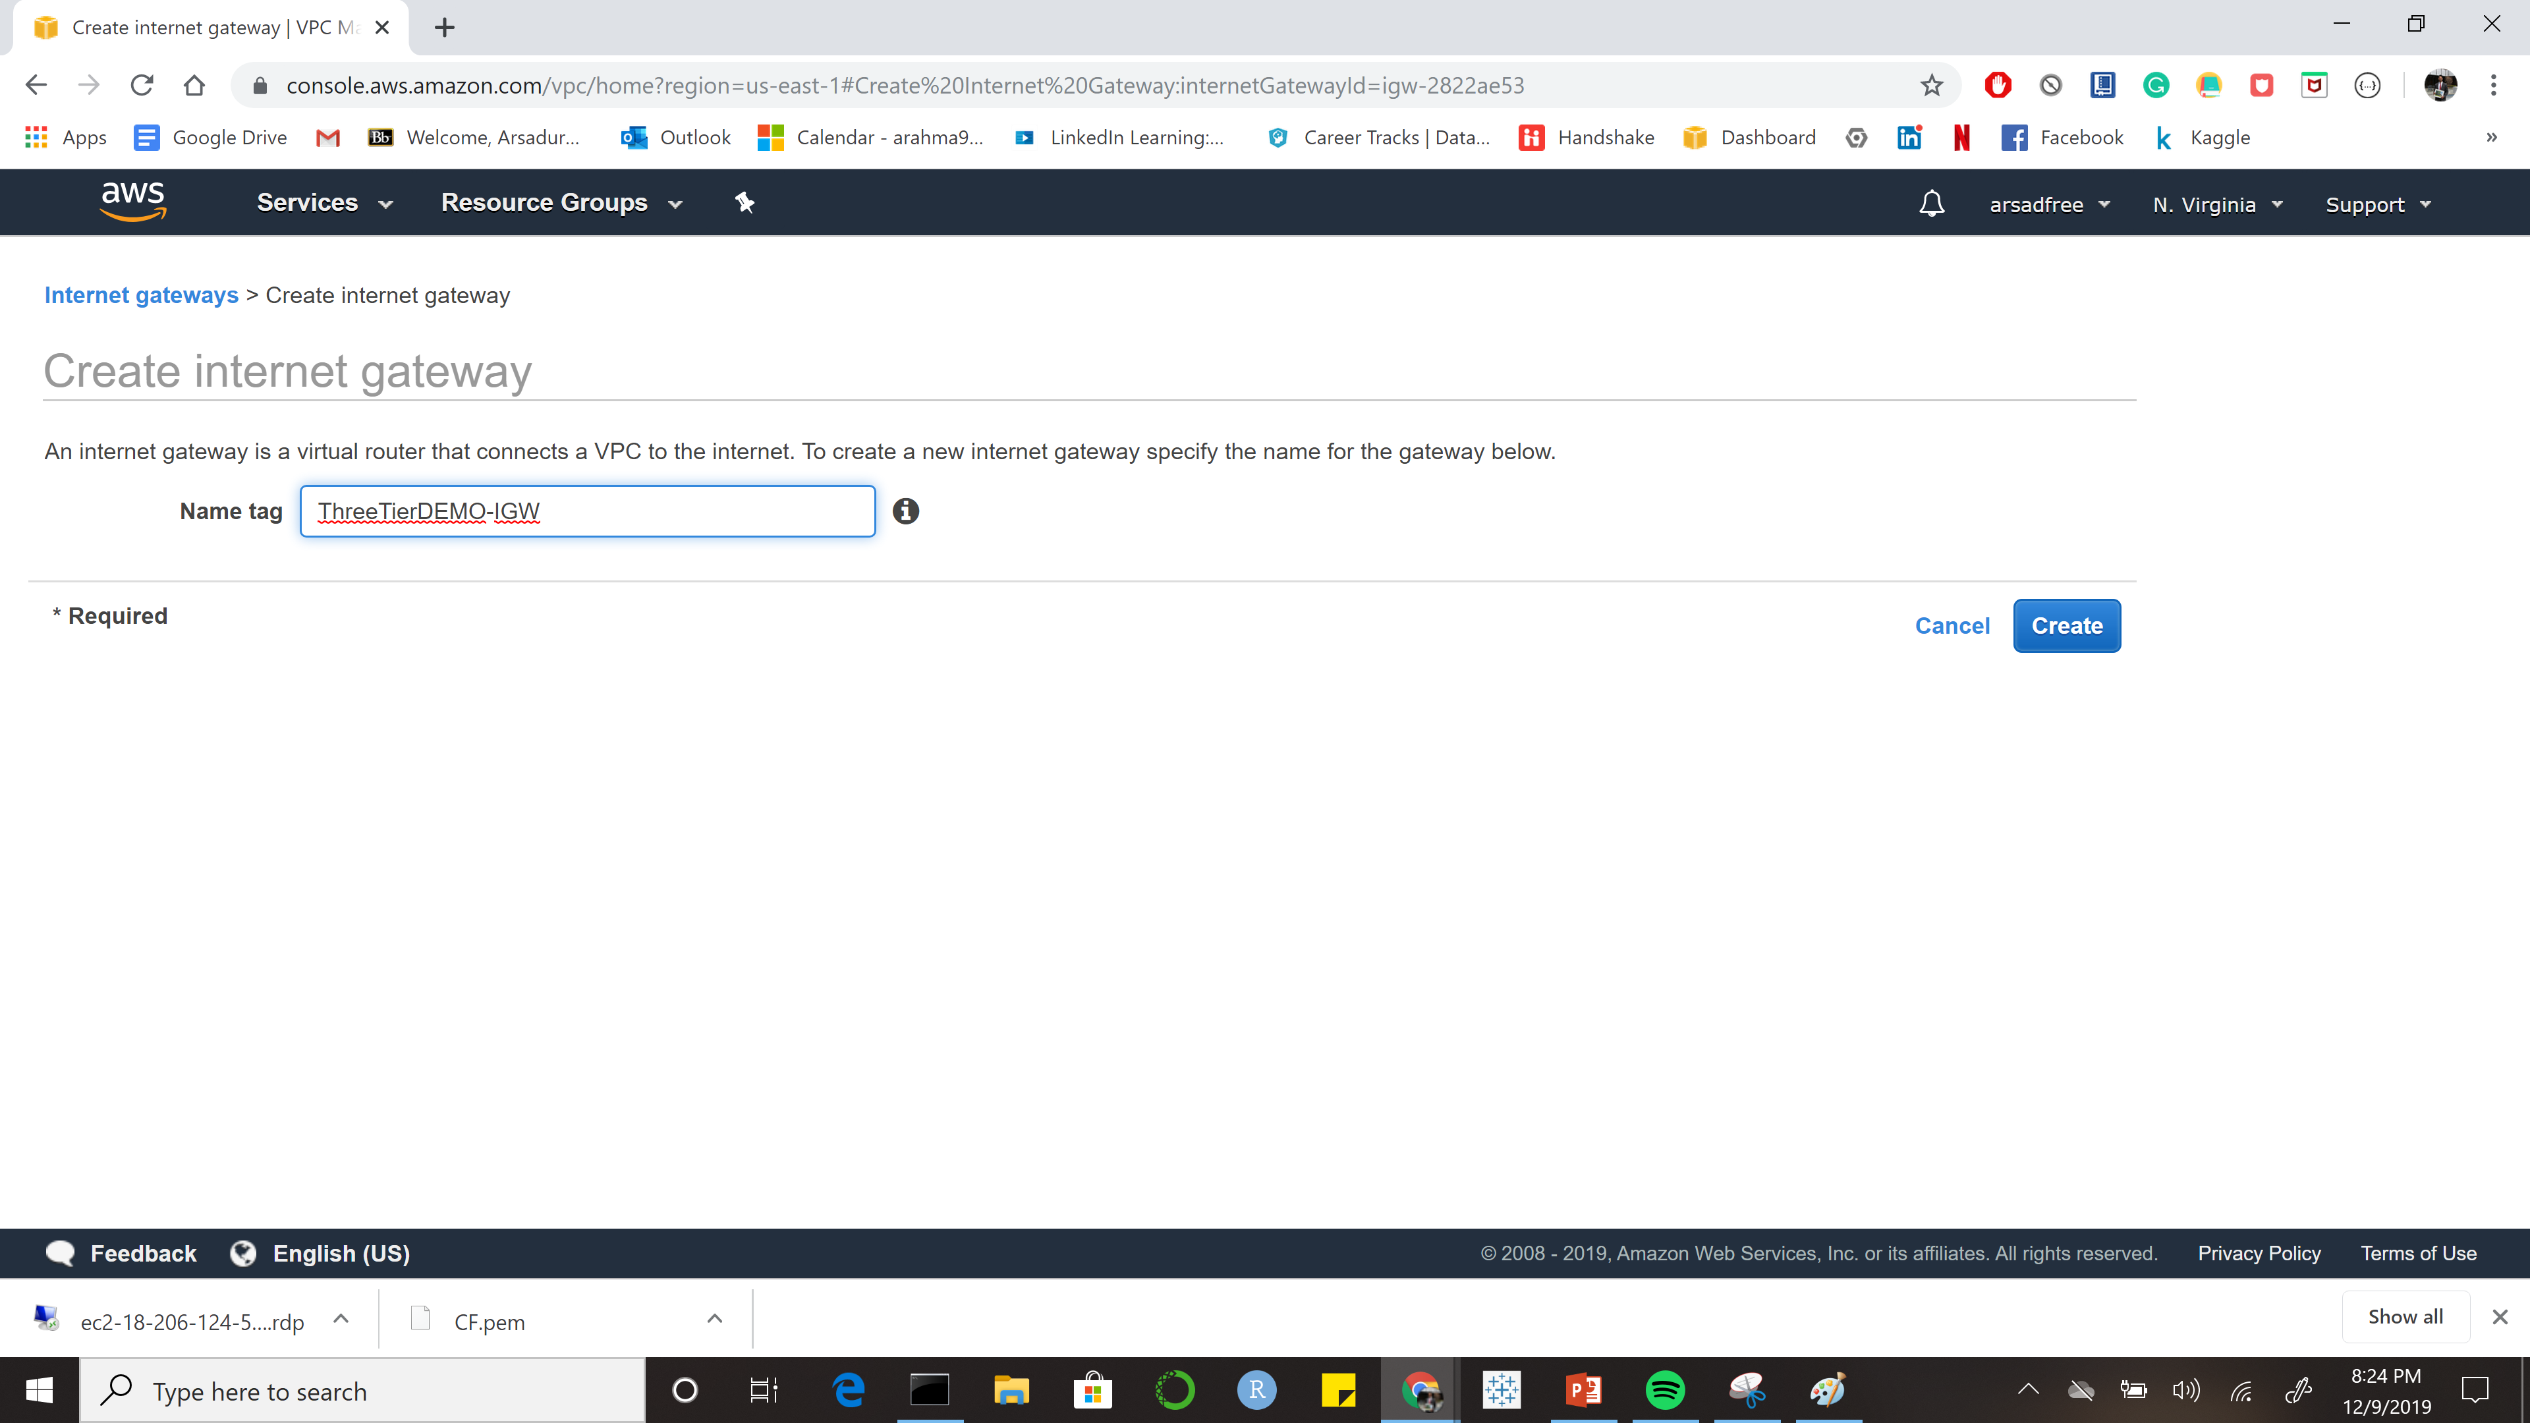

Slide 15
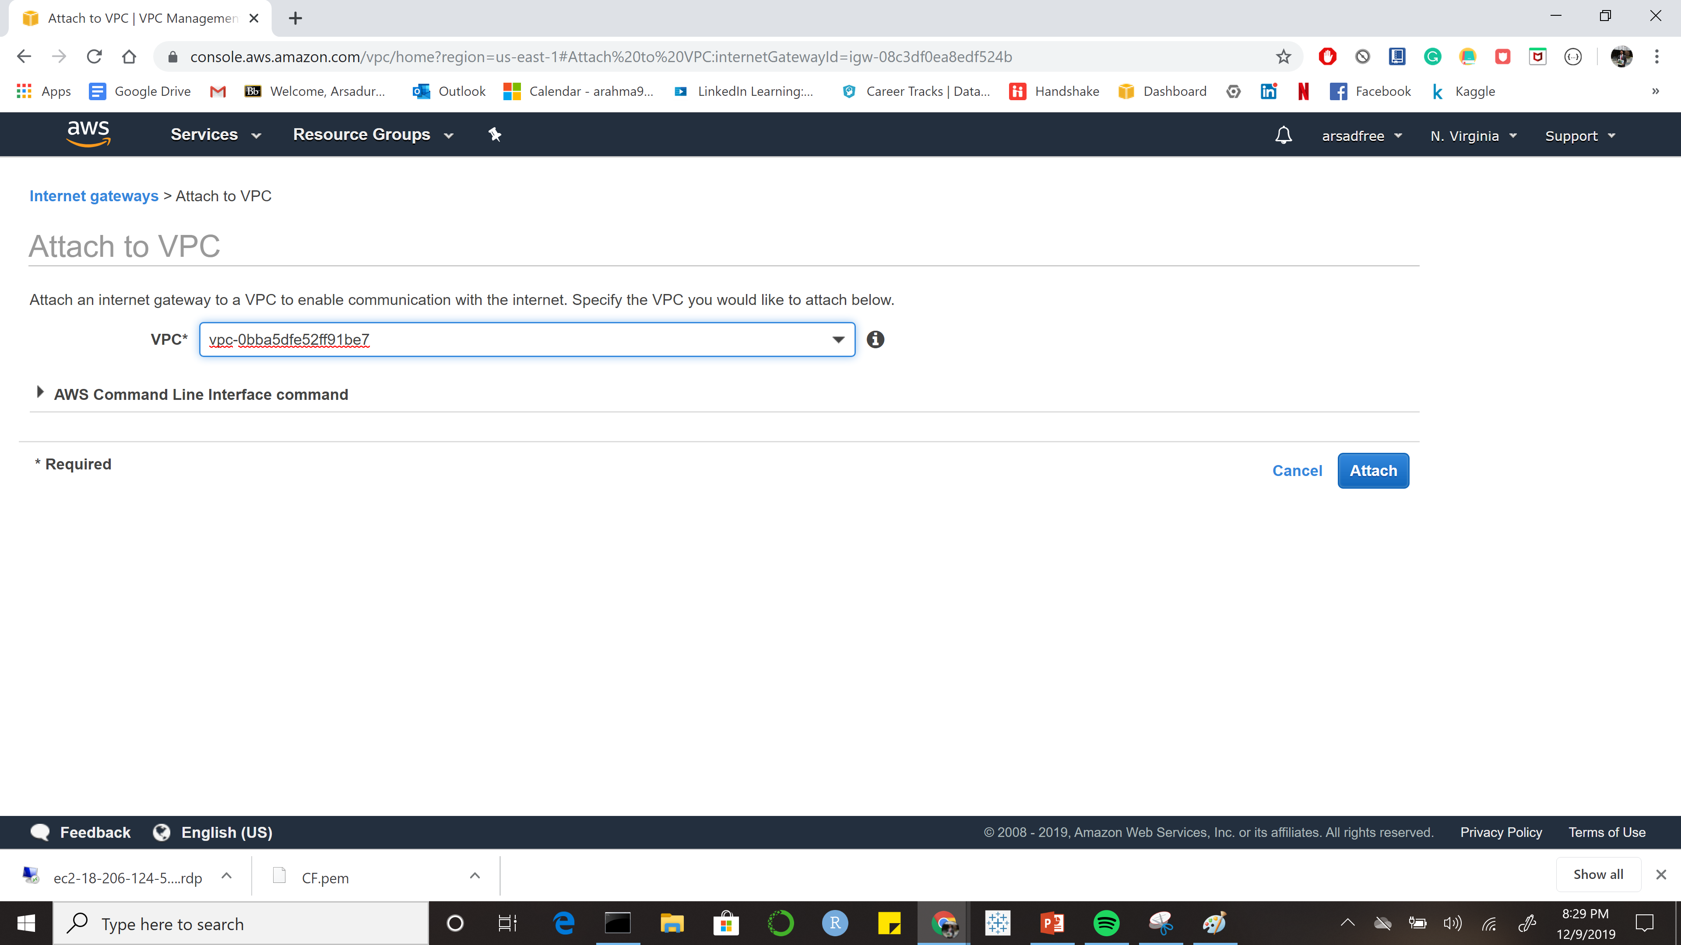

Slide 16
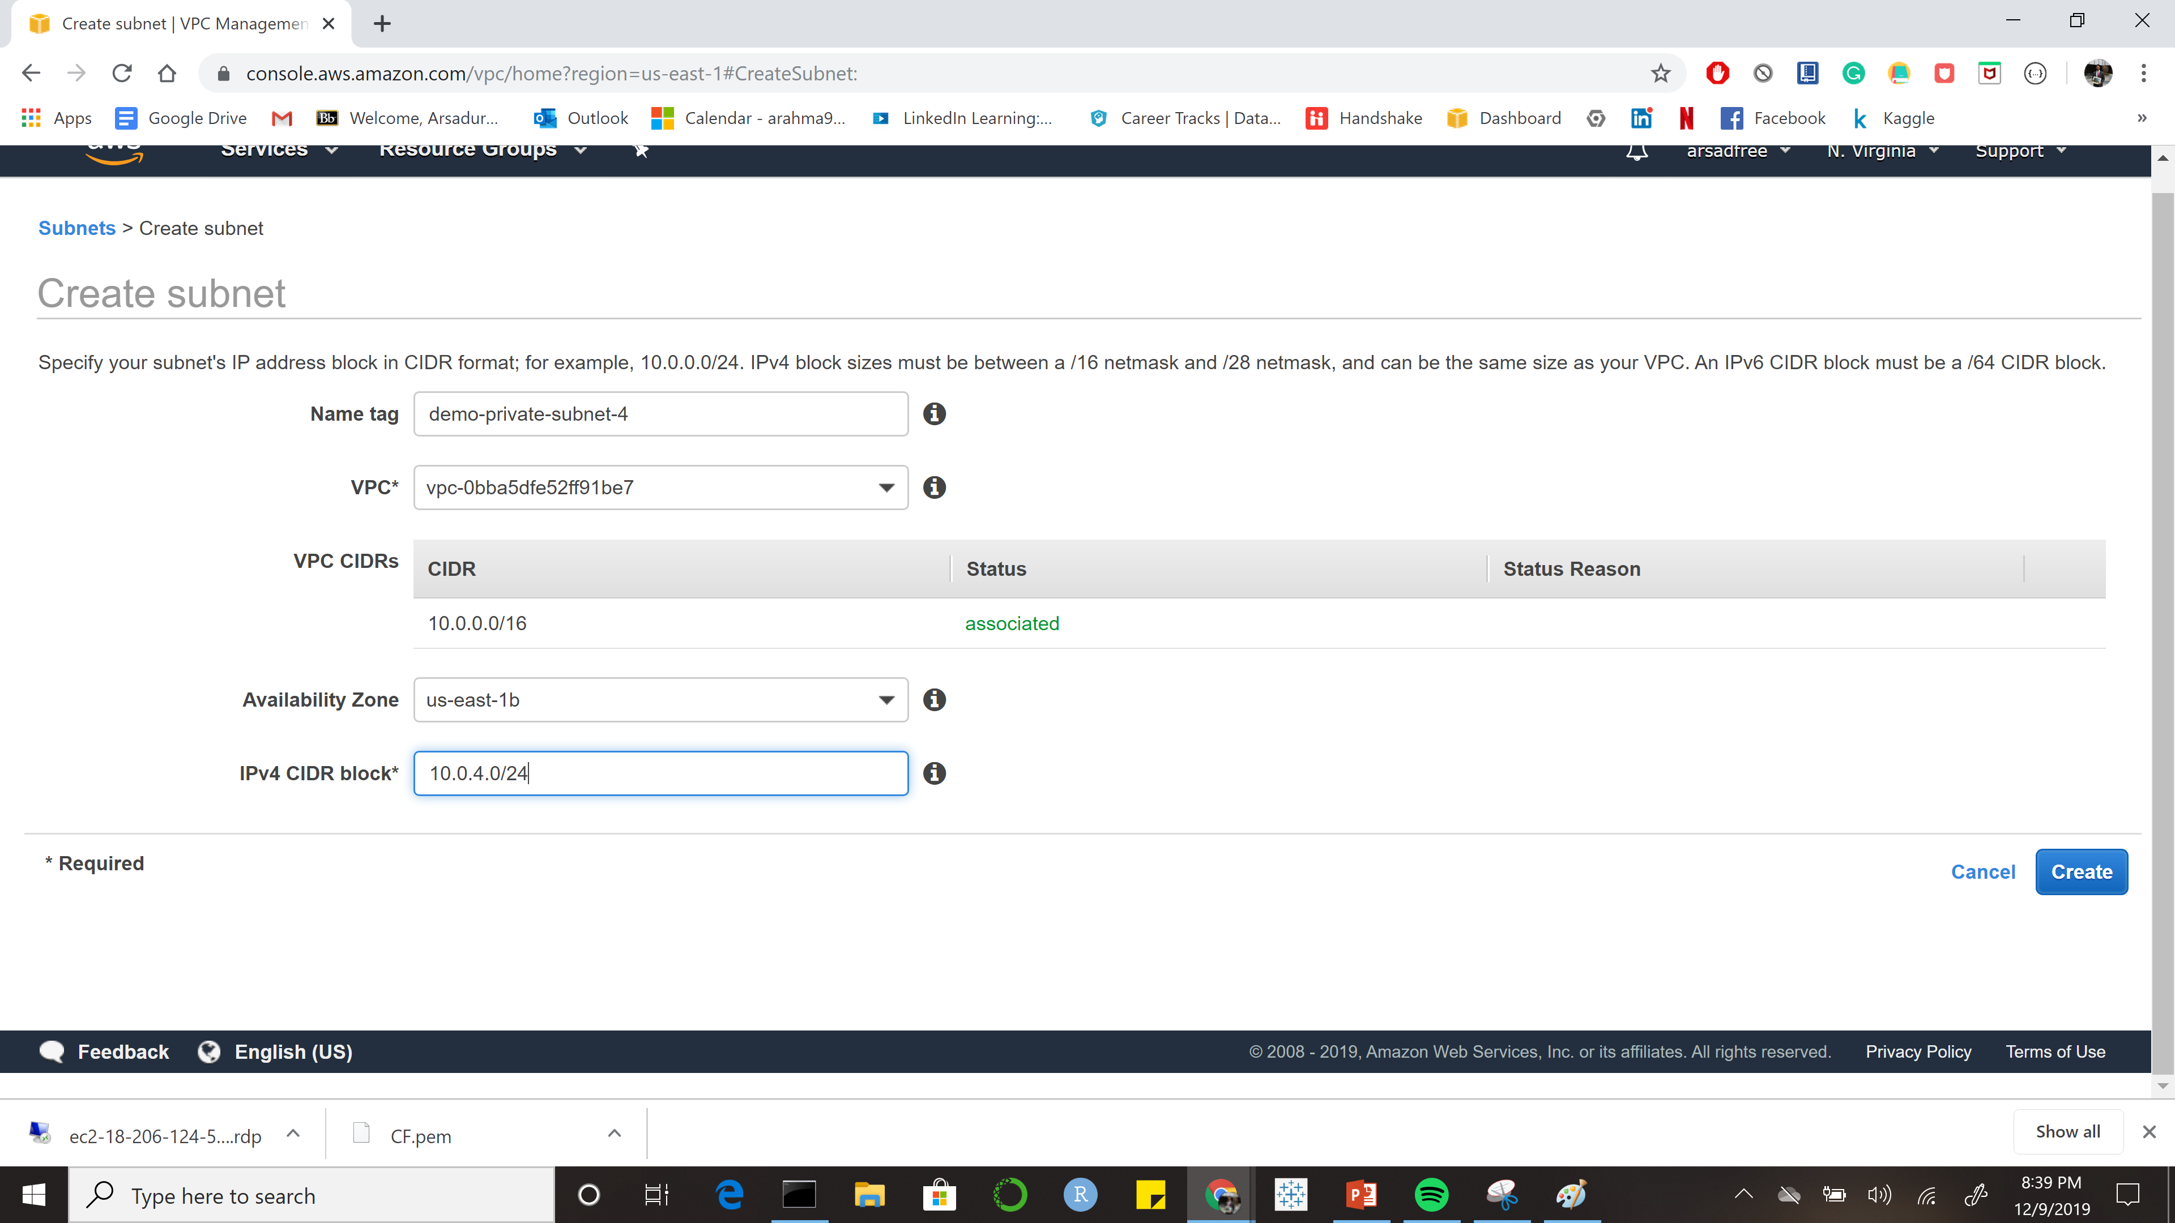

Slide 17
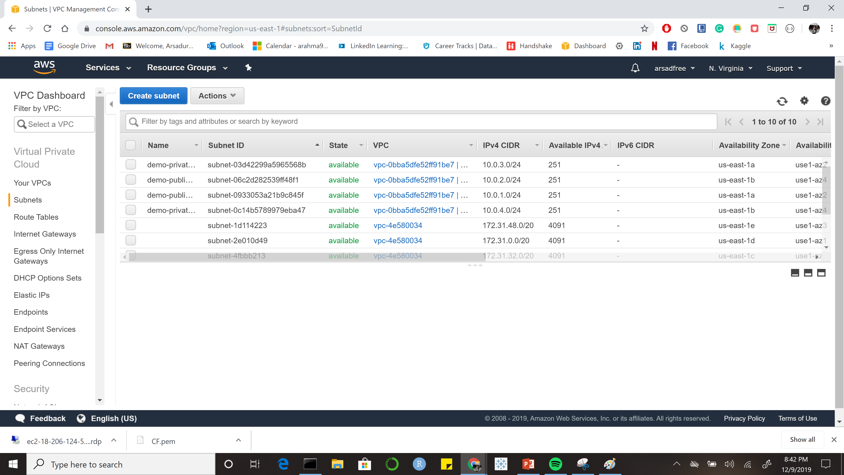

Slide 18
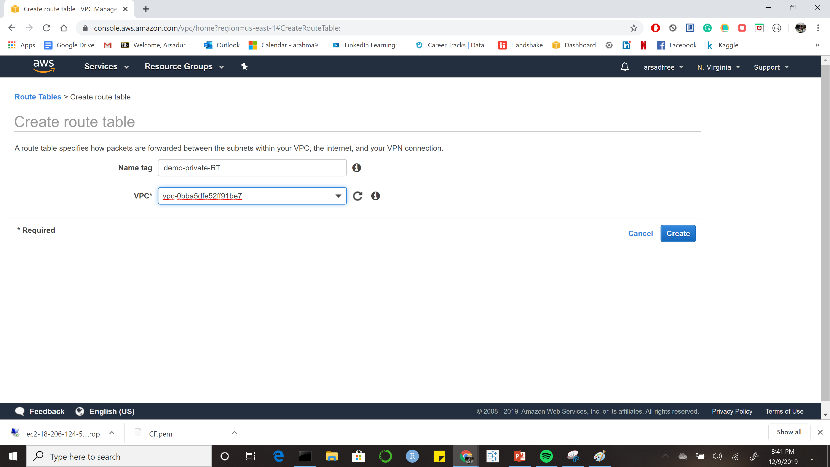

Slide 19
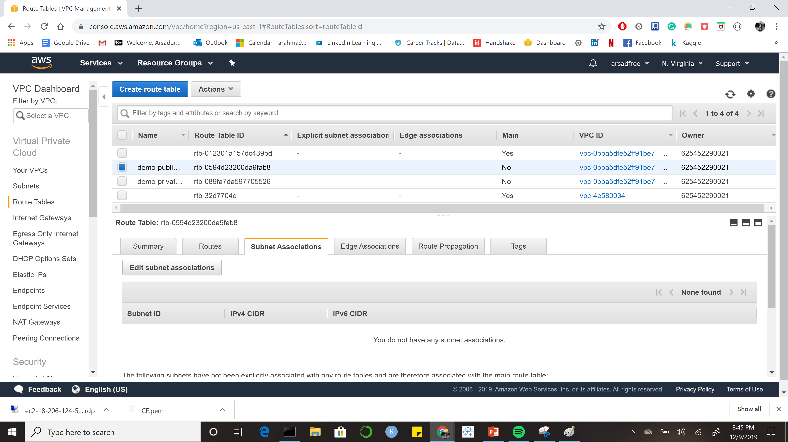

Slide 20
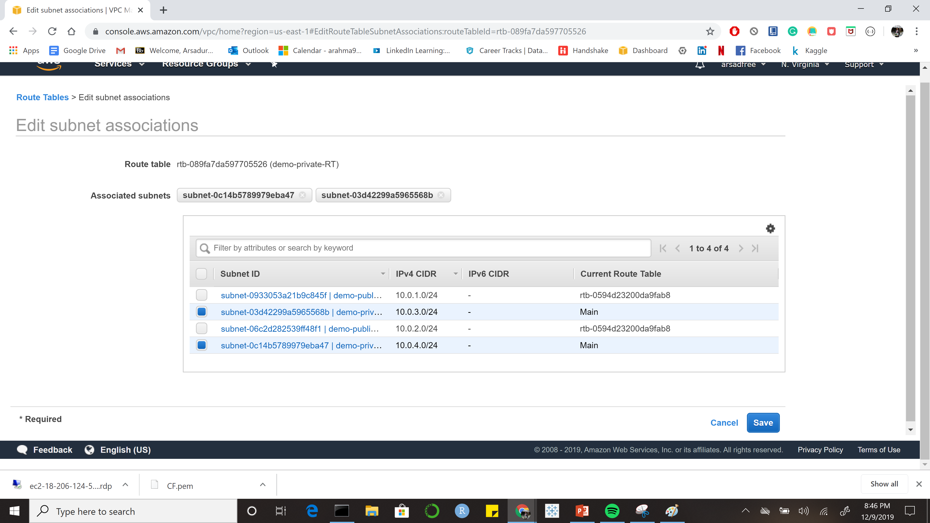

Slide 21
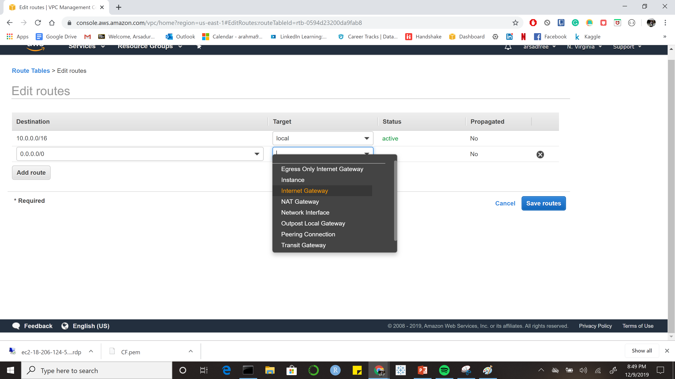

Slide 22
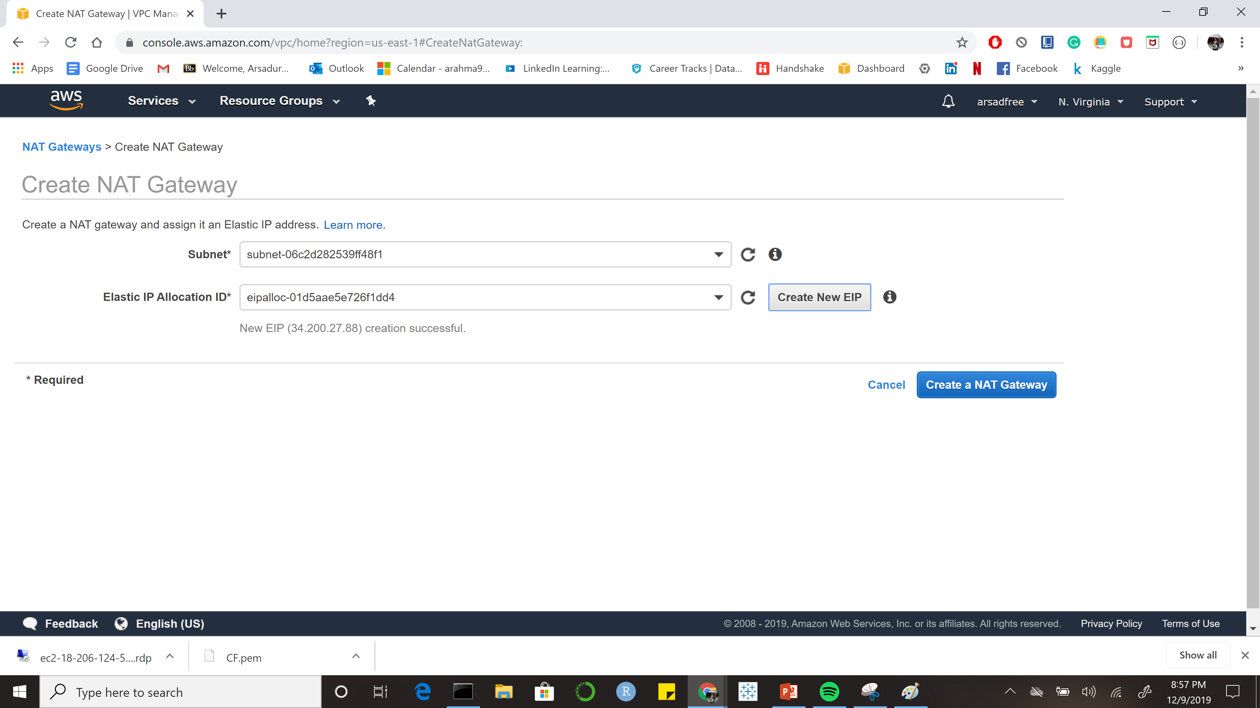

Slide 23
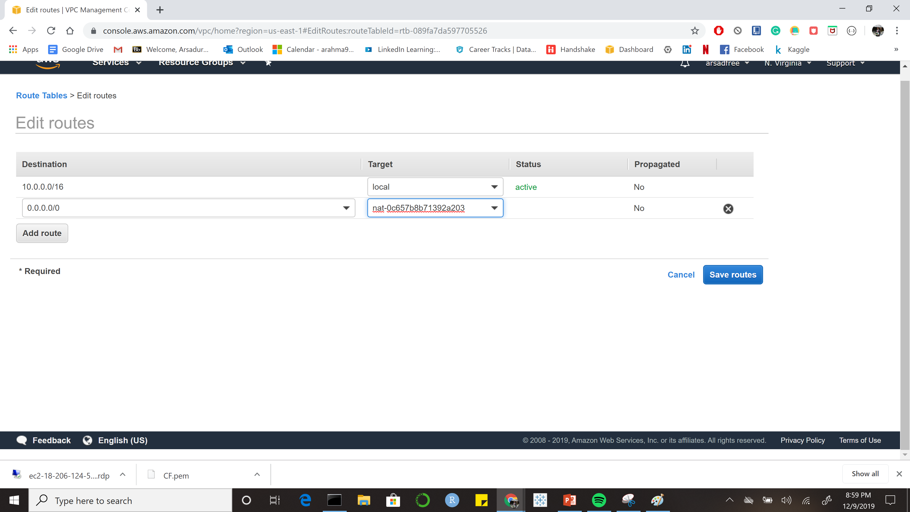

Slide 24
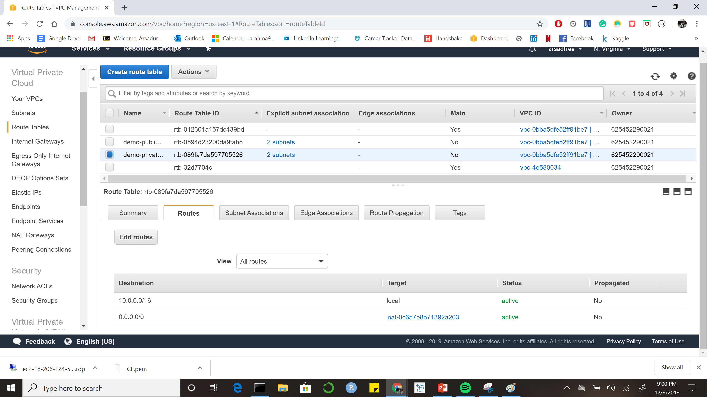

Slide 25
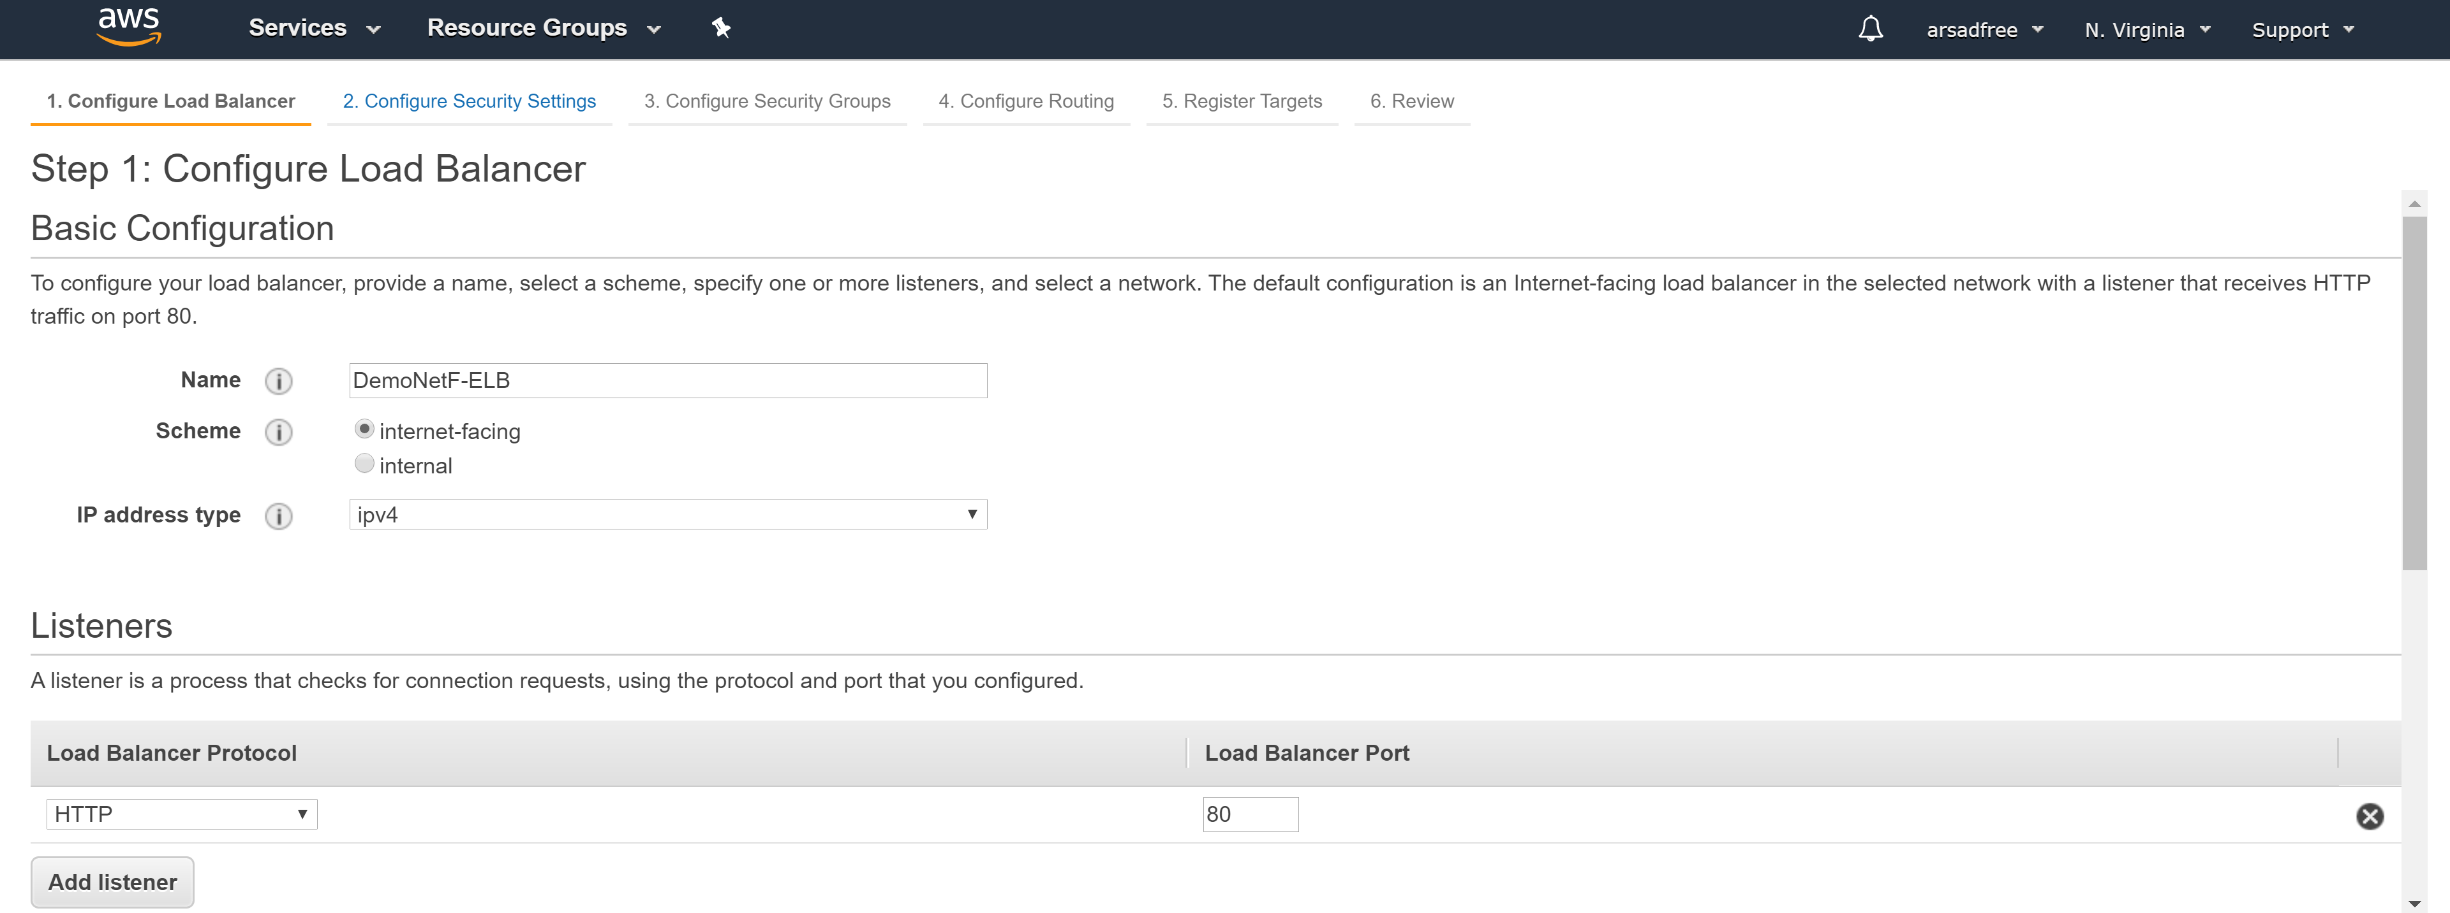
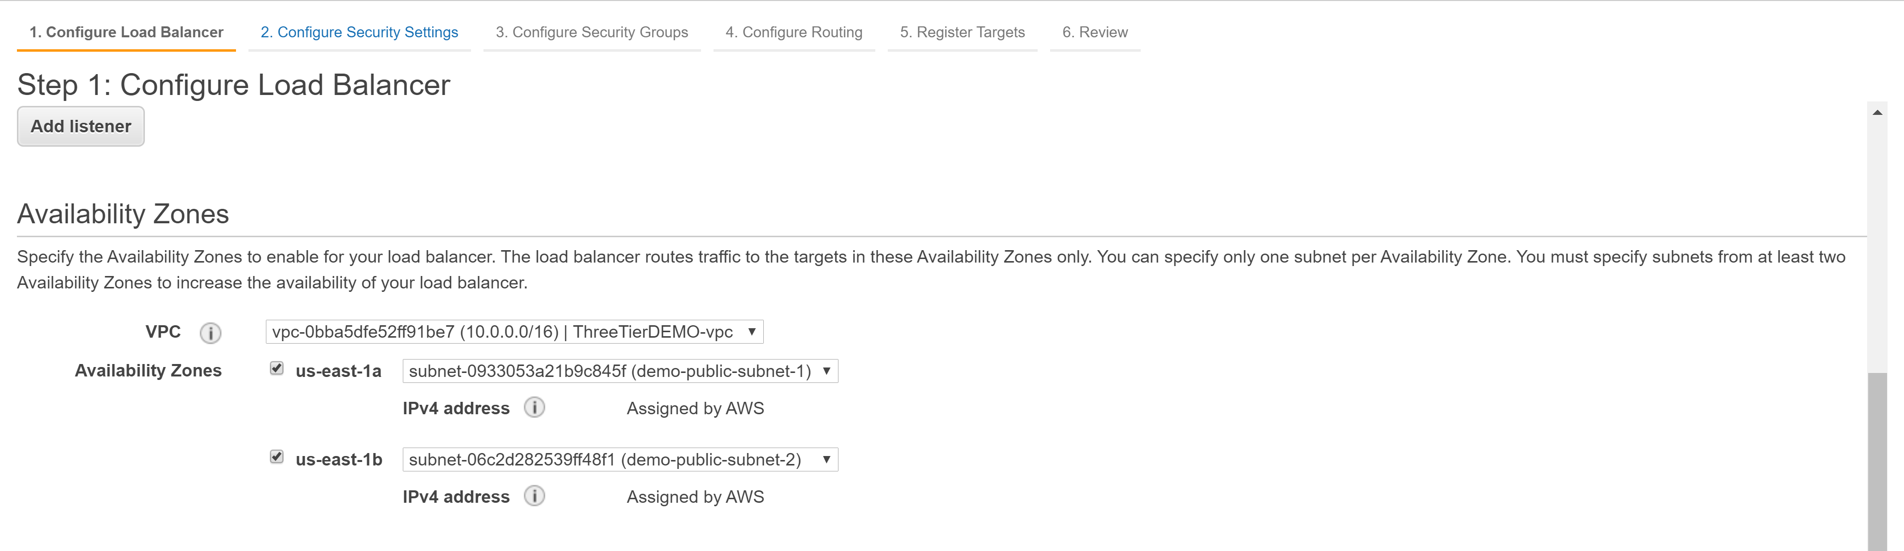

Slide 26
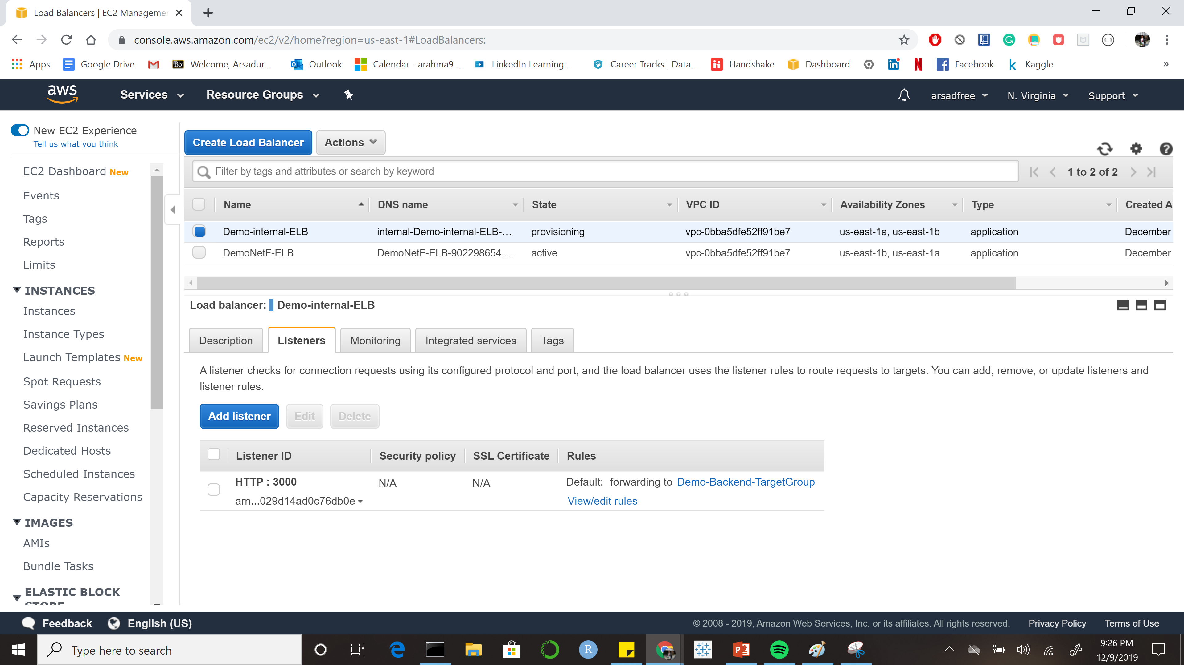

Slide 27
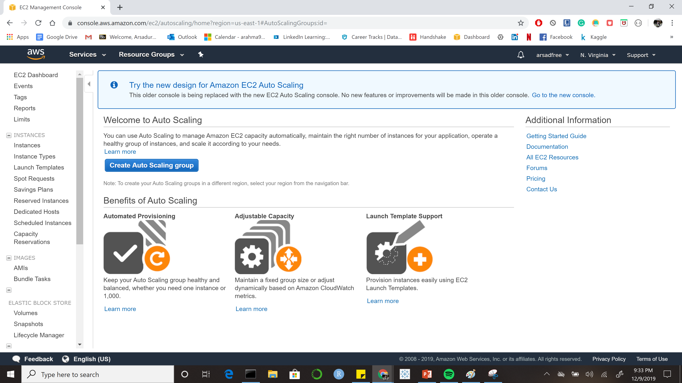

Slide 28
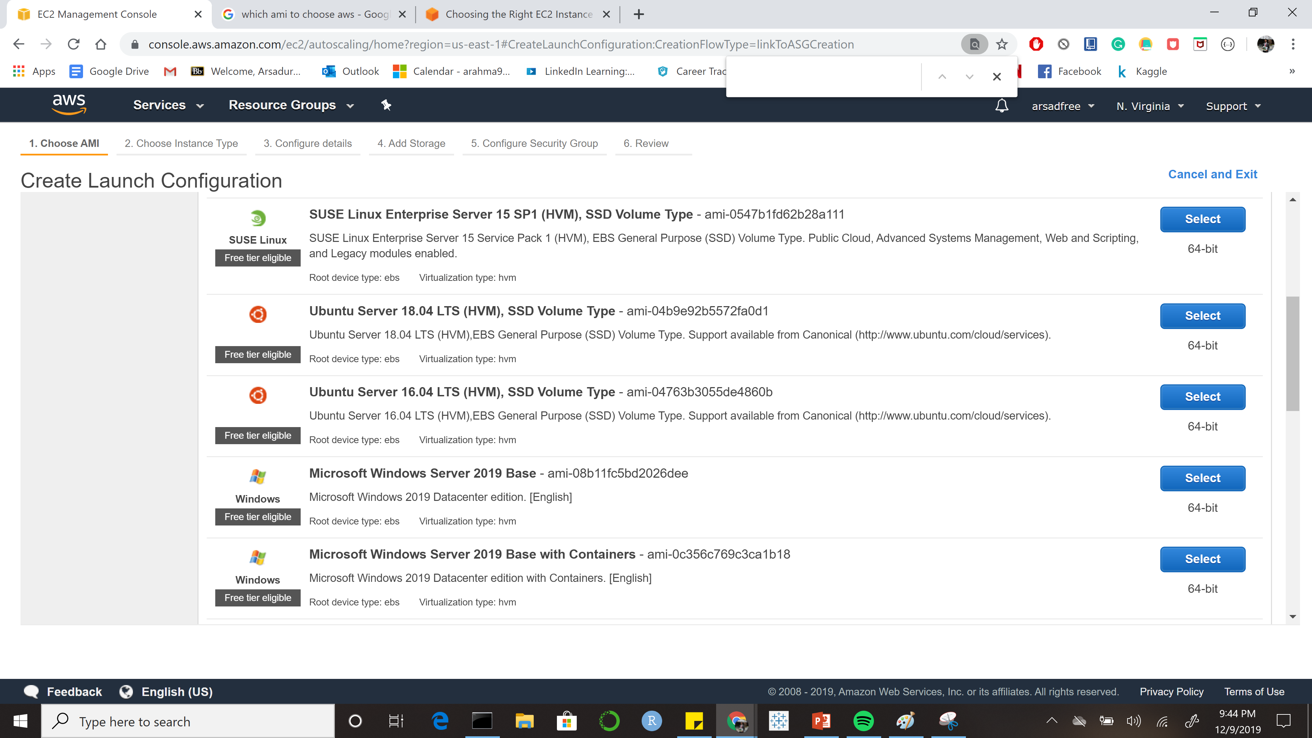

Slide 29
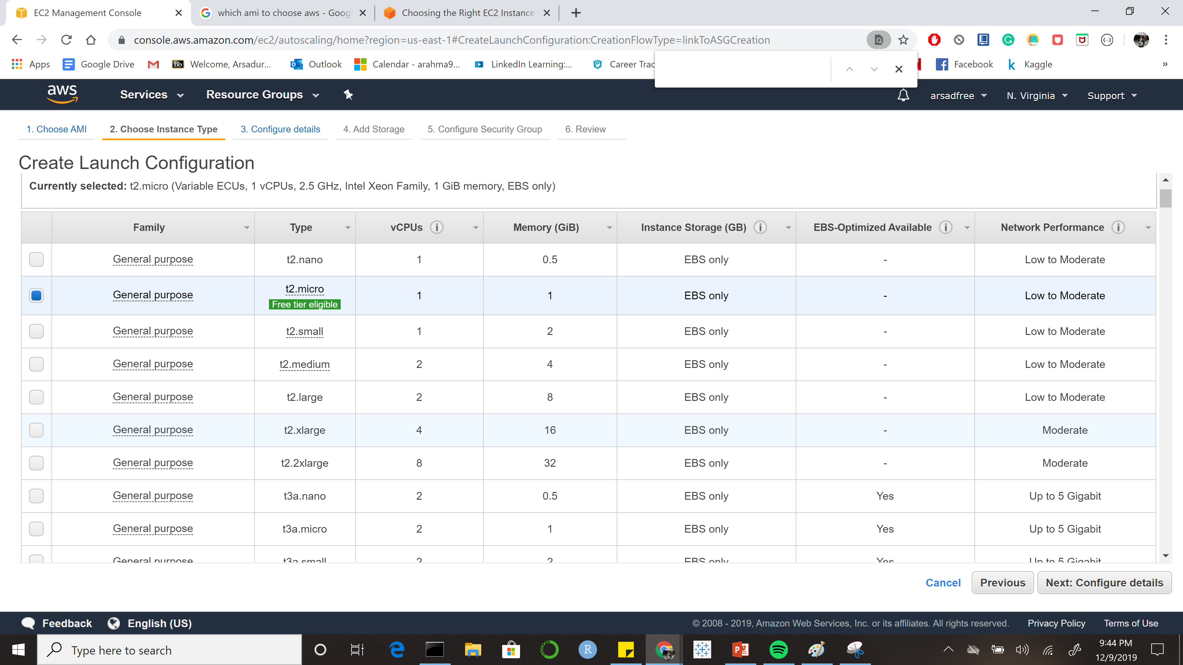

Slide 30
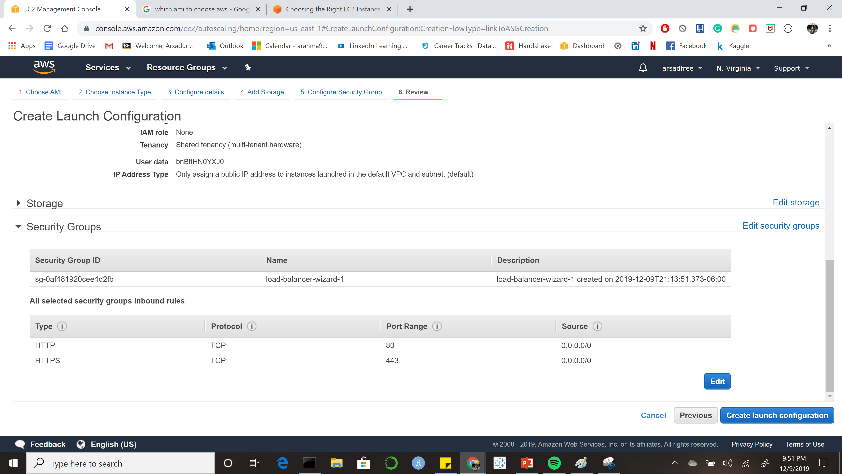

Slide 31
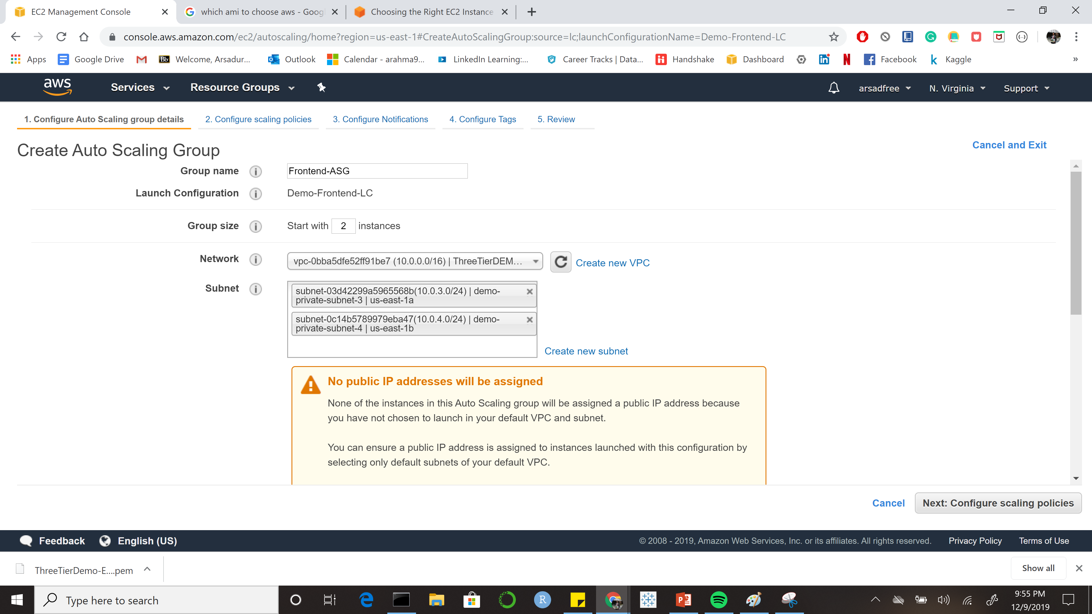

Slide 32
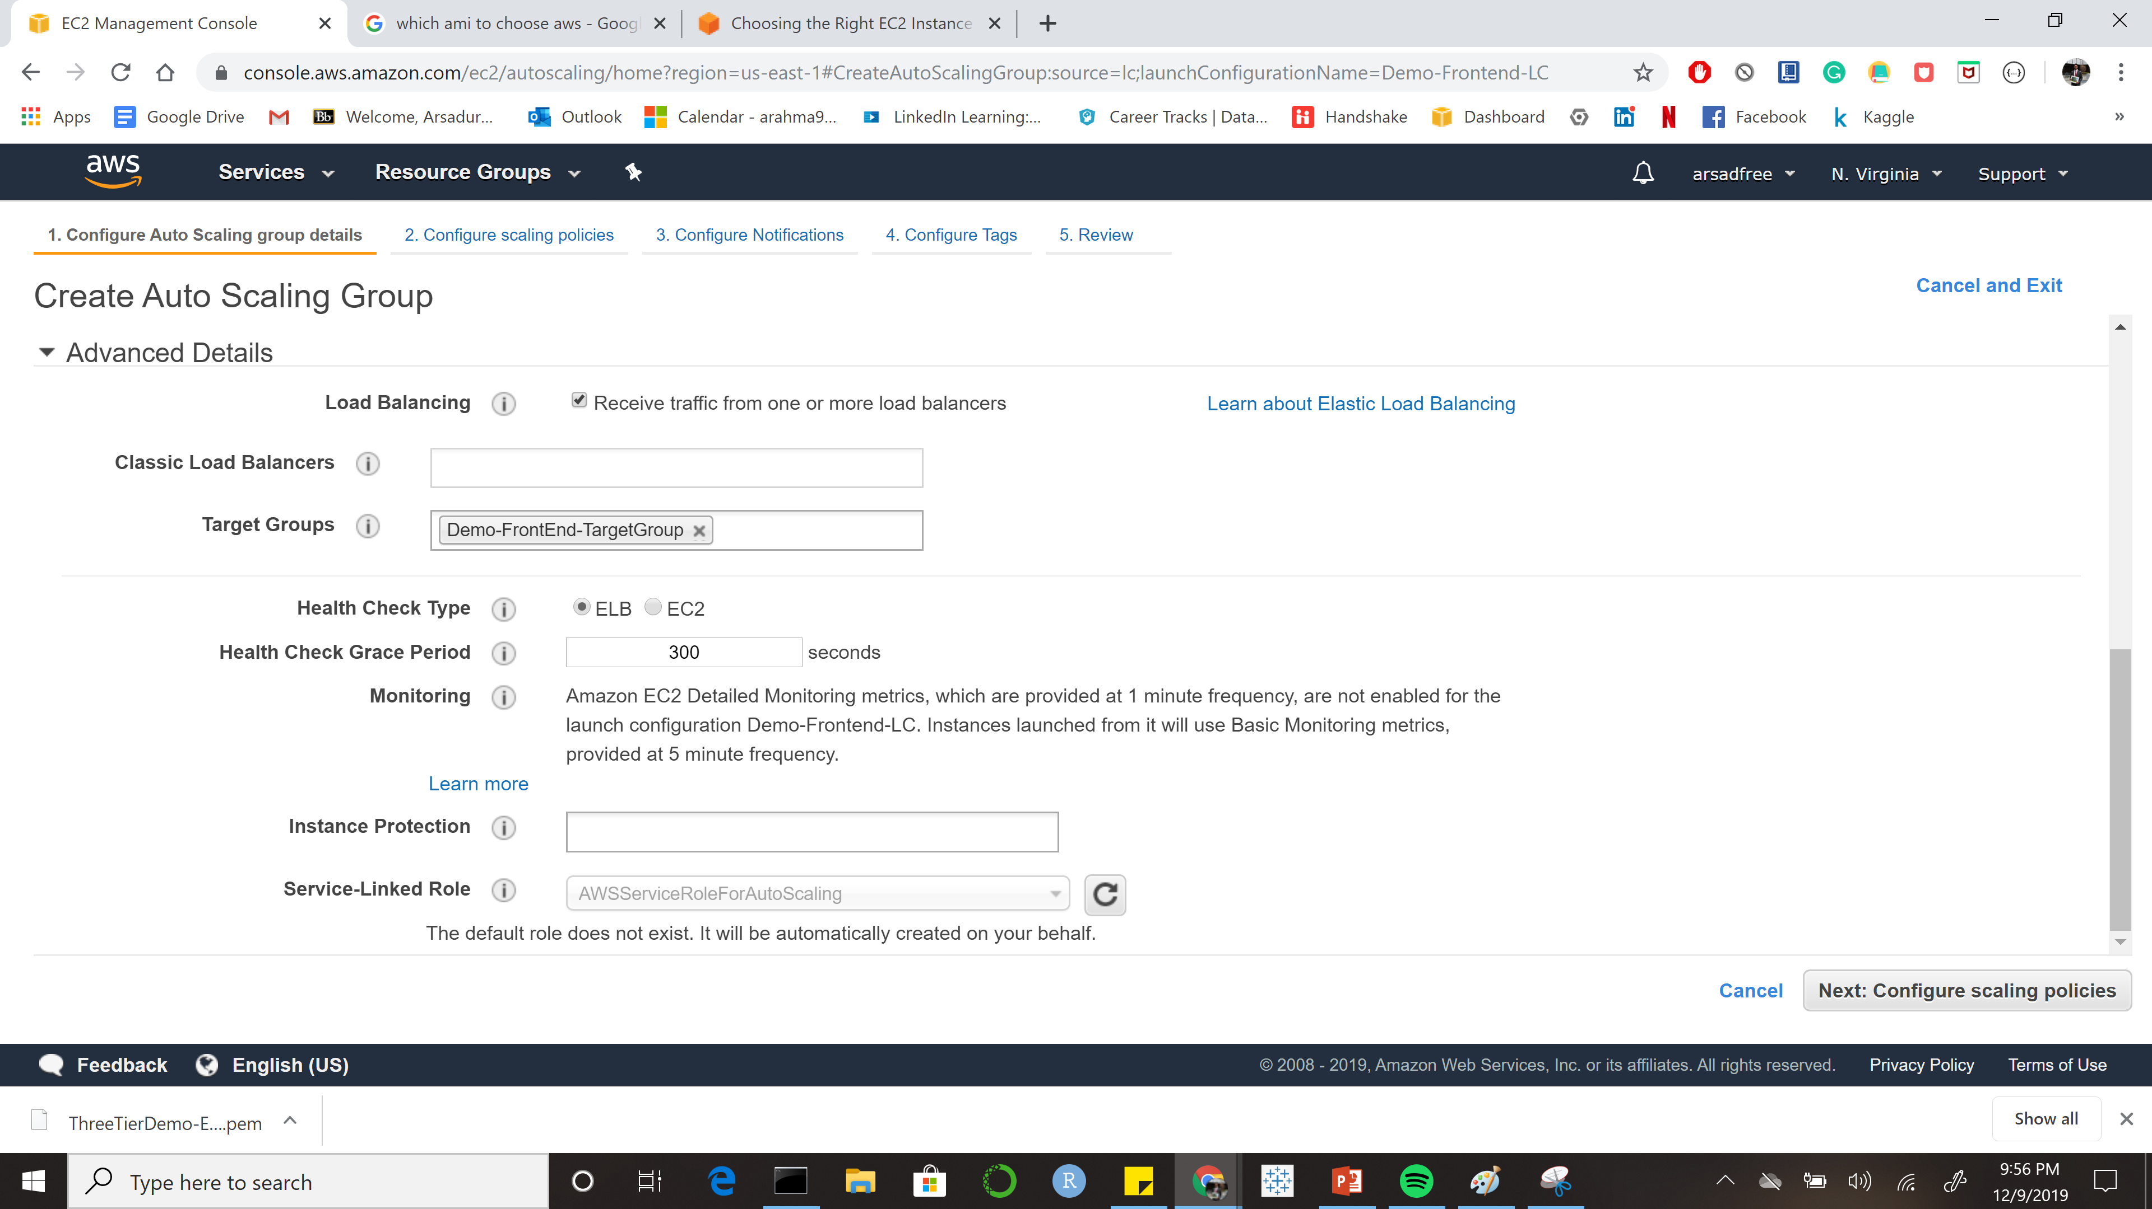

Slide 33
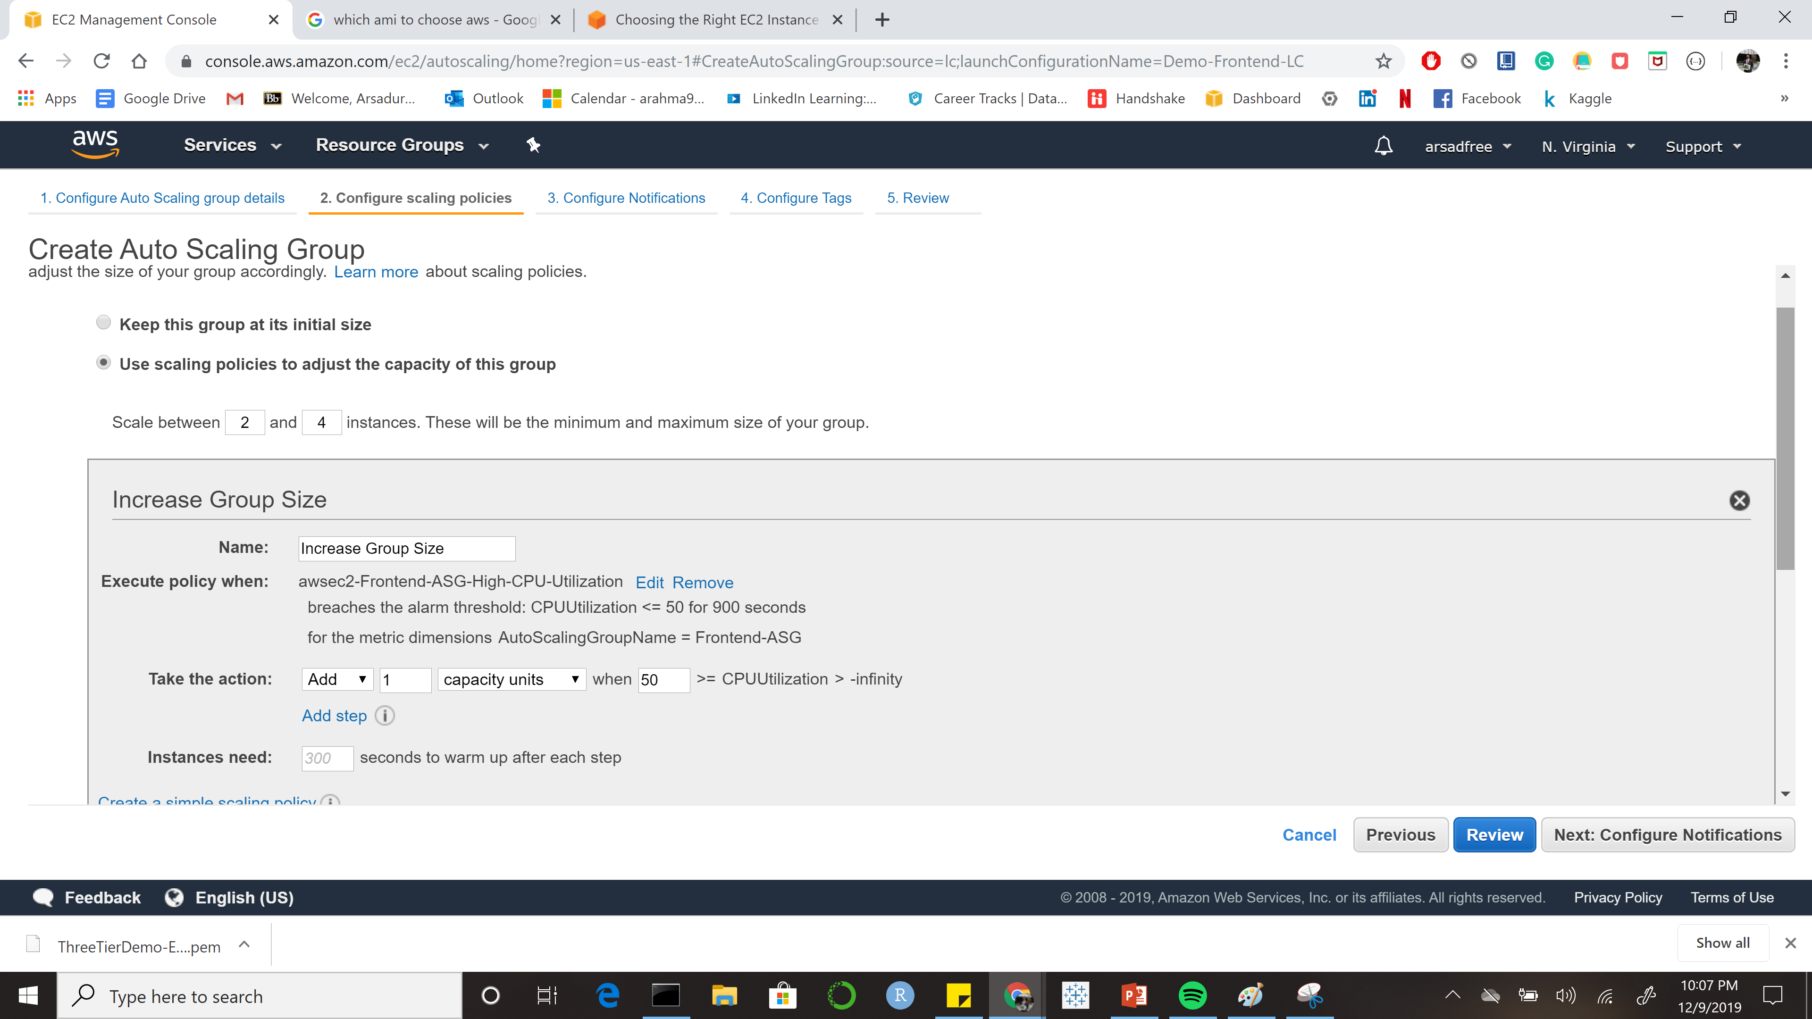

Slide 34
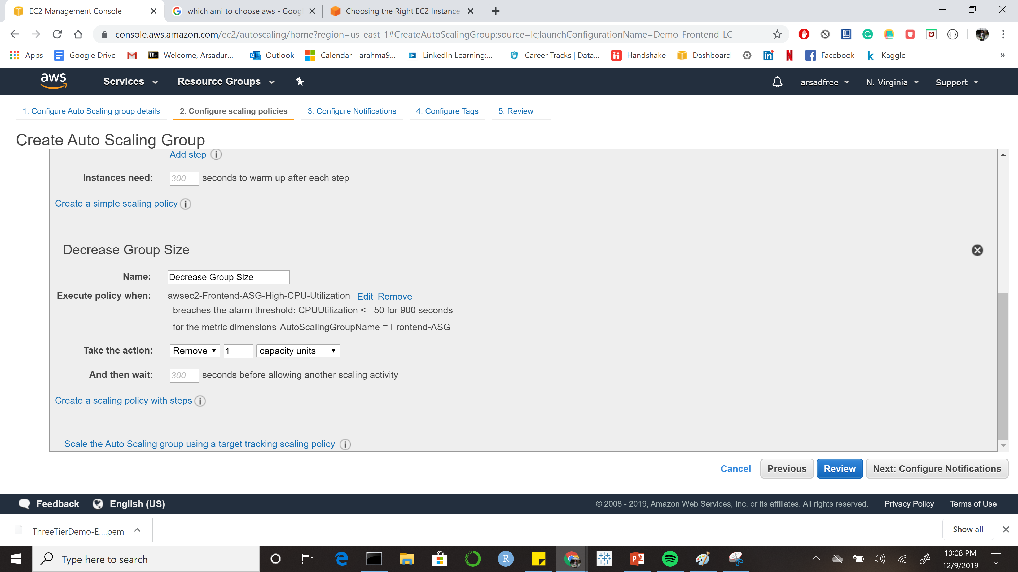

Slide 35
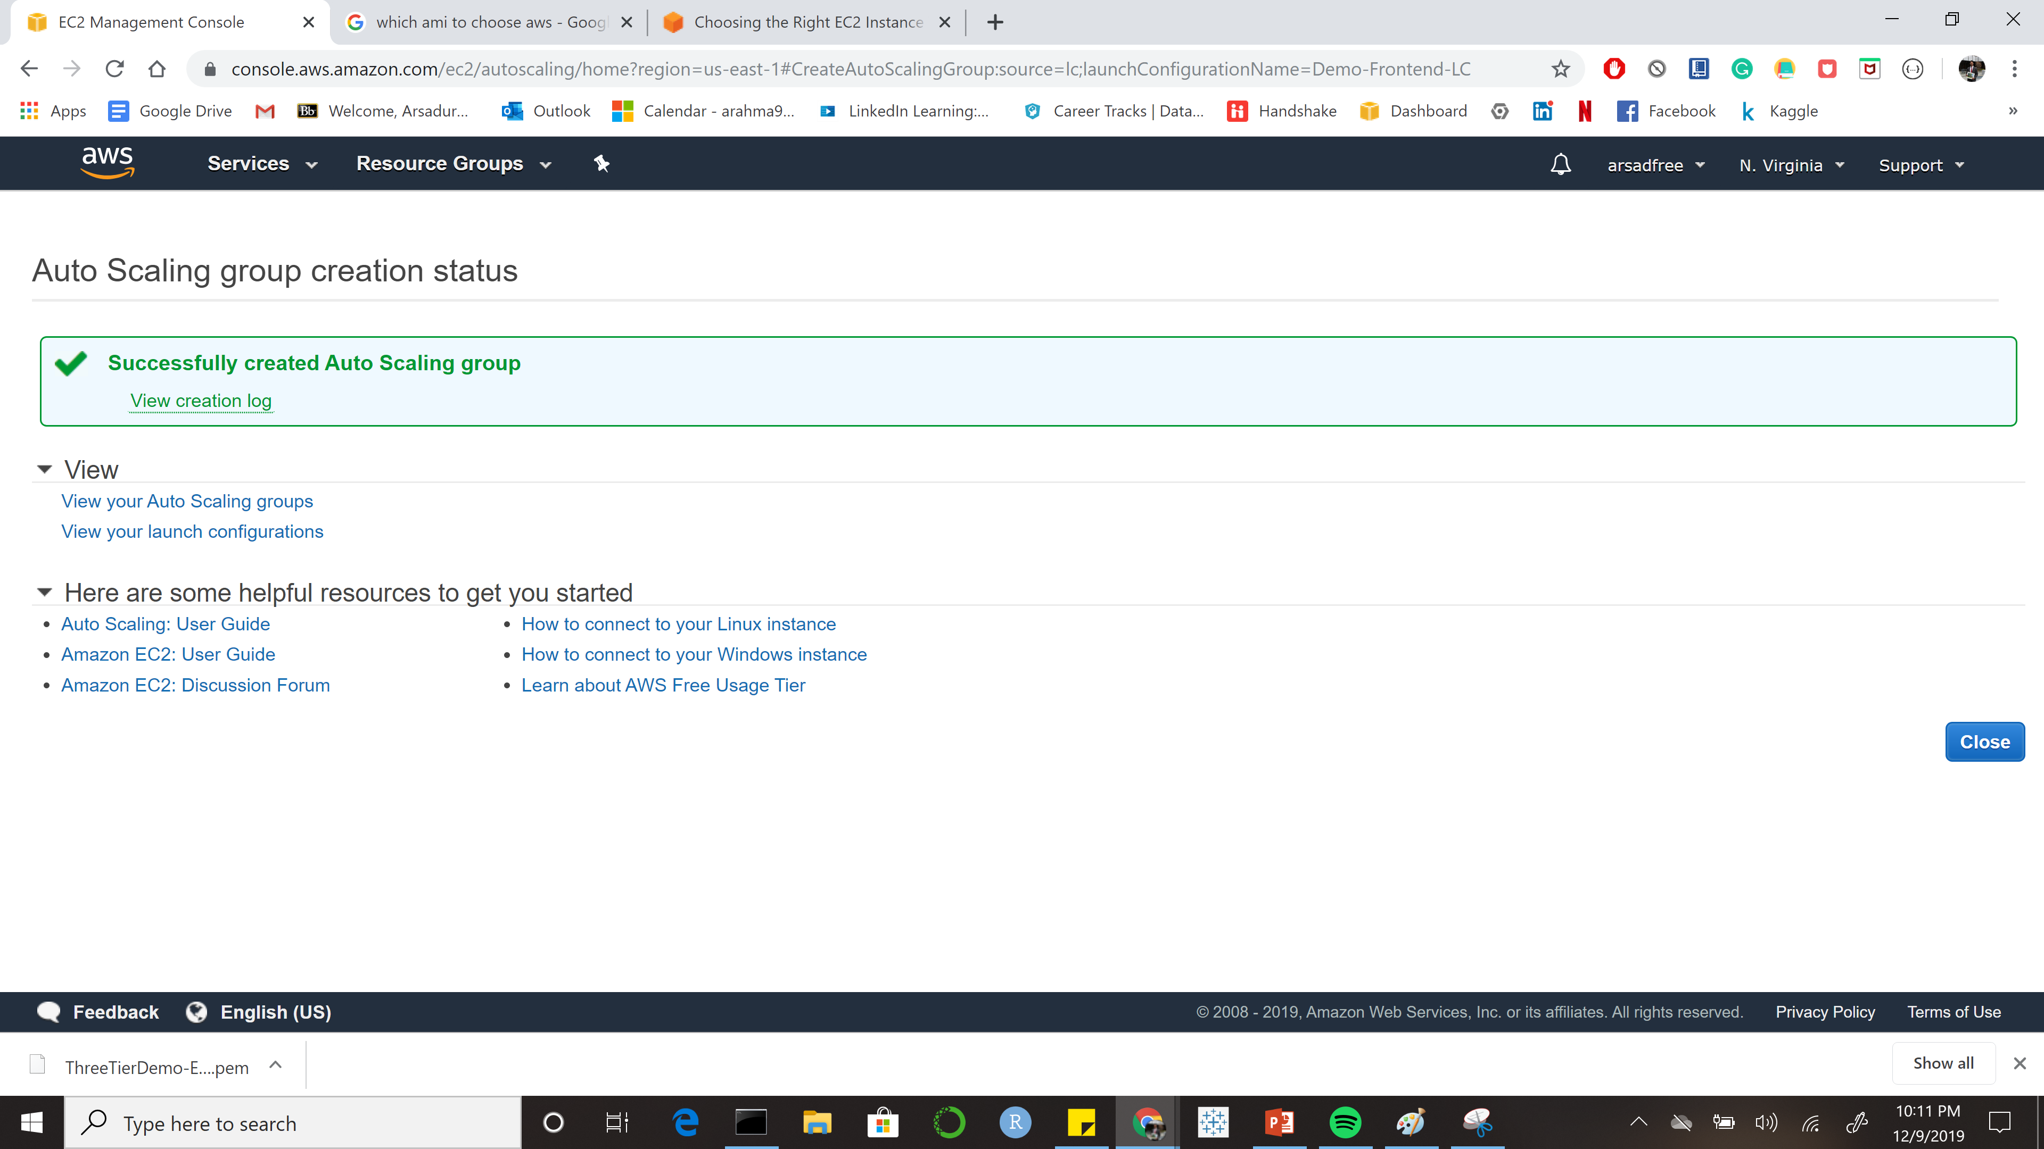

Slide 36
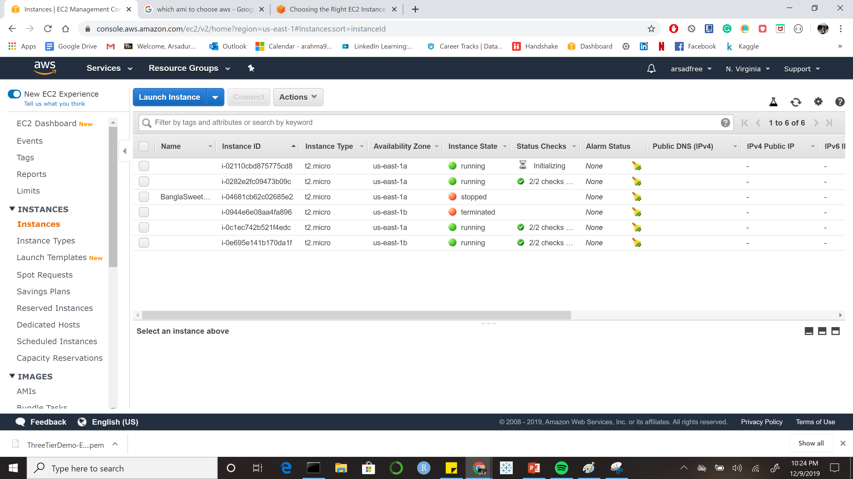

Slide 37
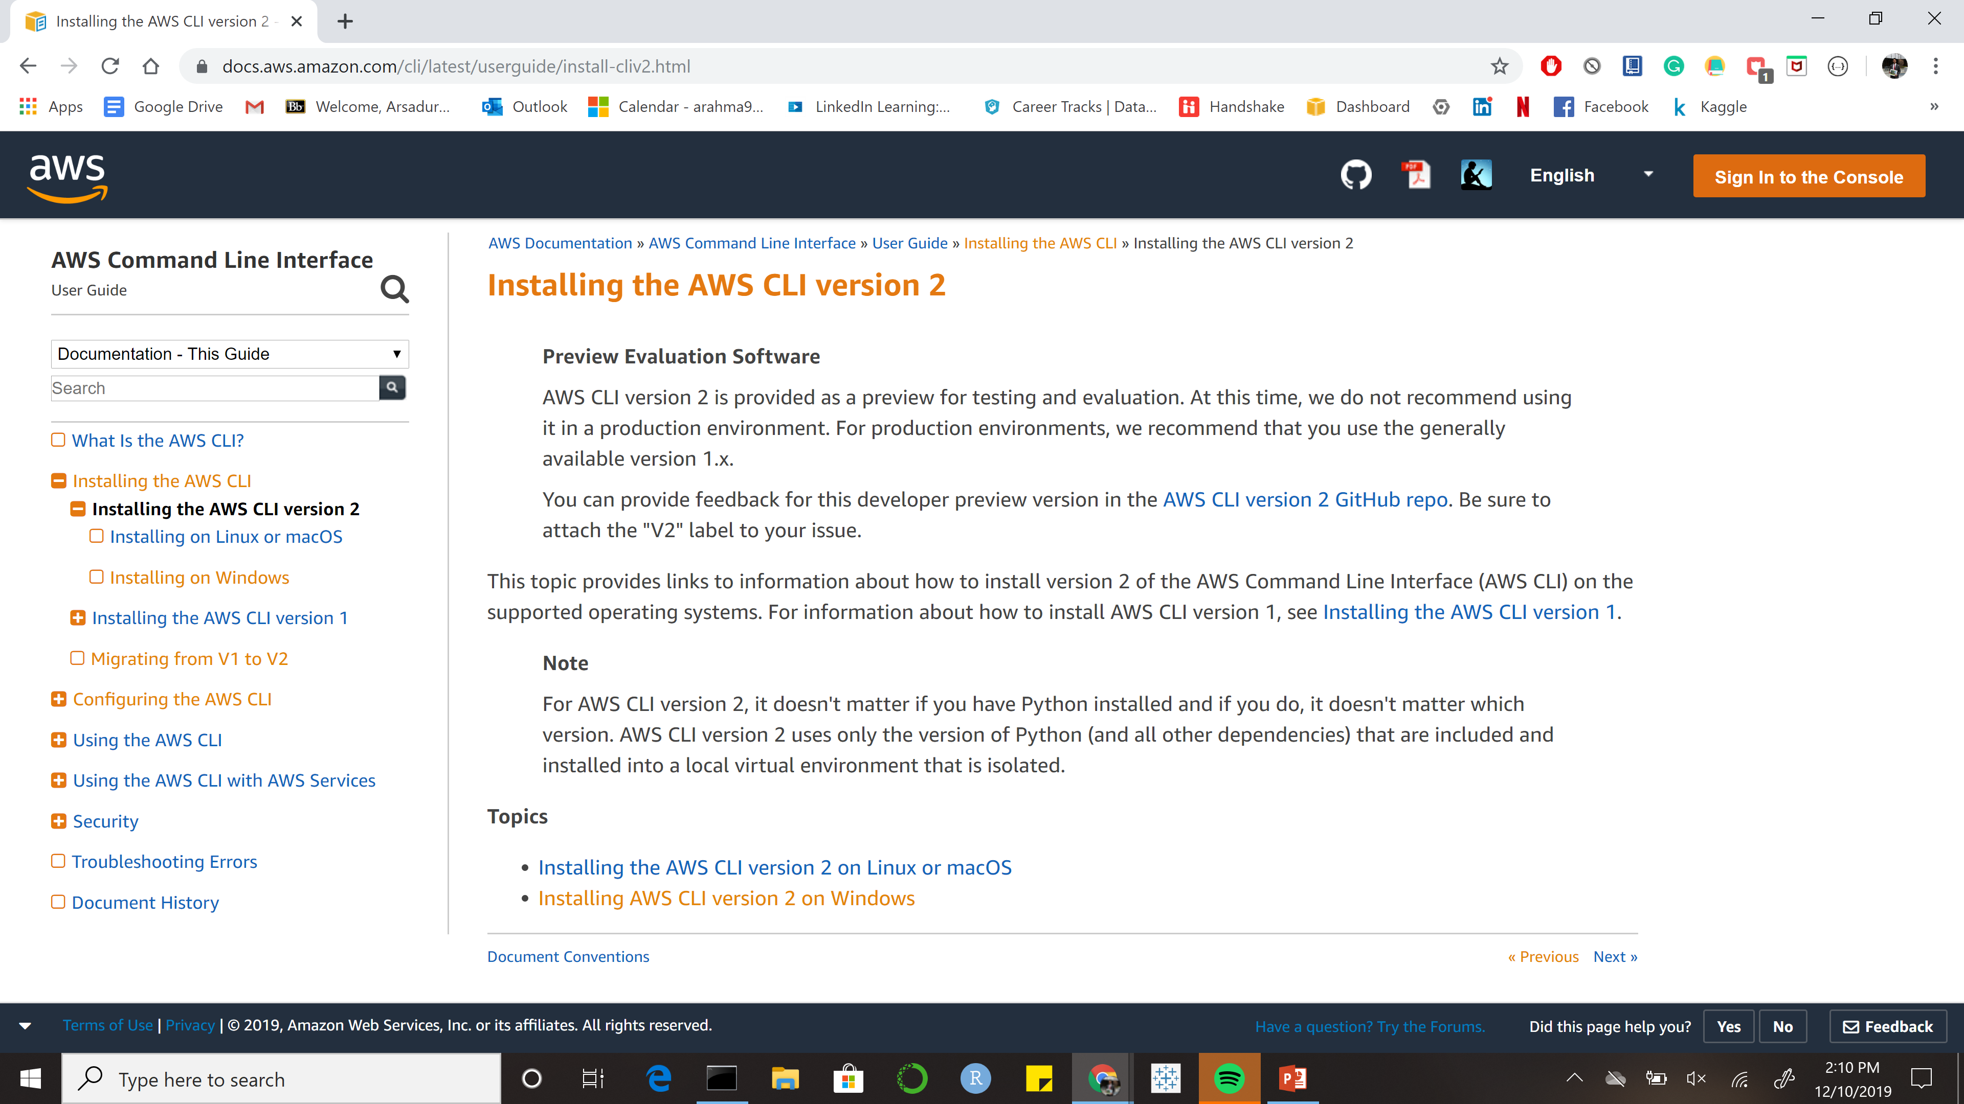
Automation- AWS Command Line Interface(CLI)

Slide 38
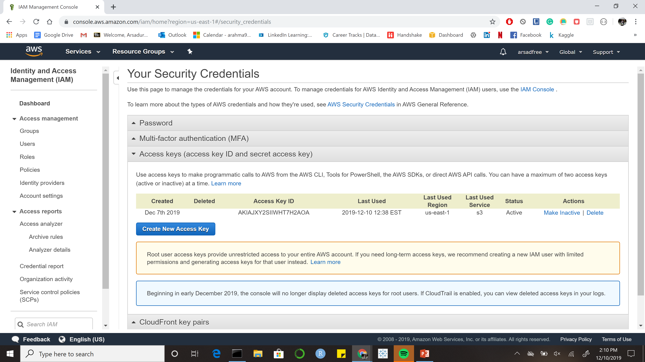
Get Security Credentials Get Access

Slide 39
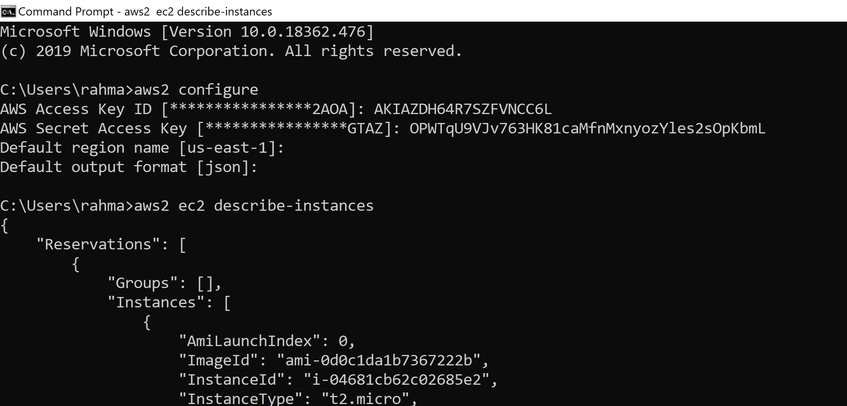

Slide 40
CLI DEMO
Start EC2 - aws2 ec2 run-instances --image-id ami-00068cd7555f543d5 --count 1 --instance-type t2.micro
Add Tag - aws2 ec2 create-tags --resources i-0c4e8ce5063542087 --tags Key=Name,Value=EC2fromCLI
Stop EC2 – aws2 ec2 stop-instances --instance-ids i-09e9e7ebe91085065
Terminate EC2 - aws2 ec2 terminate-instances --instance-ids i-09e9e7ebe91085065

Slide 41
Thank You!
Question?
References
https://aws.amazon.com/blogs/aws/building-three-tier-architectures-with-security-groups/
https://docs.aws.amazon.com/cli/index.html?nc2=h_ql_doc_cli

